Slide 1
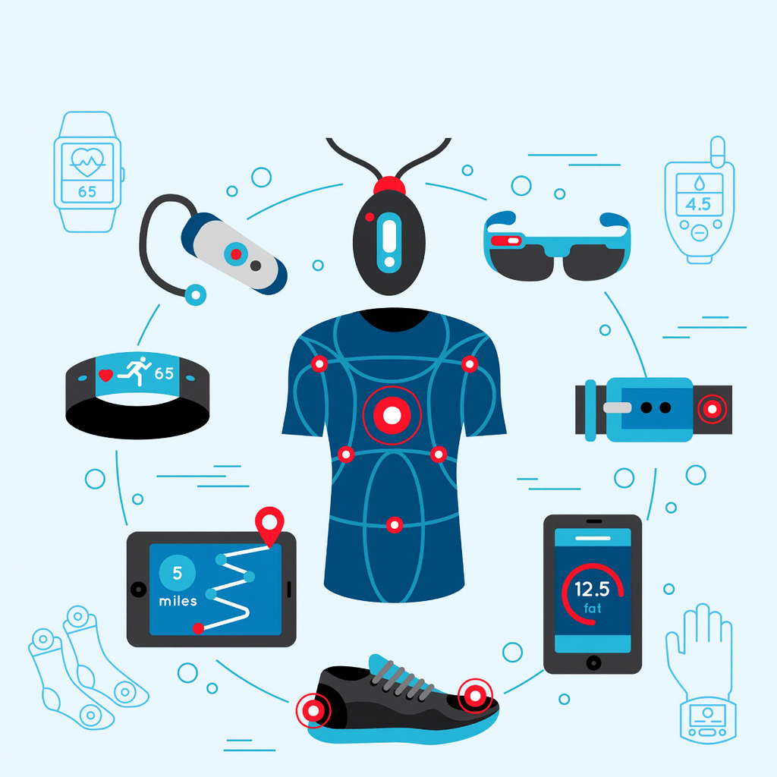
Compromised by Design
The Hidden Risks of Wearables
Notes:
Choices have consequences. And sometimes, the consequences do not hit us until much later. Wearable smart devices are a choice. Insightful, motivational, convenient, and sometimes, even lifesaving.
Wearables are our biological extensions, collecting and streaming in real time, a vast amount of biological and location data to various data hungry third parties across the world.
This presentation is not a rejection or an advocacy of wearables. It is an examination of two things
The risks presented by wearables collecting and streaming our biological and location data in real time, and
How we can continue using these devices without trading away our safety and control

Slide 2
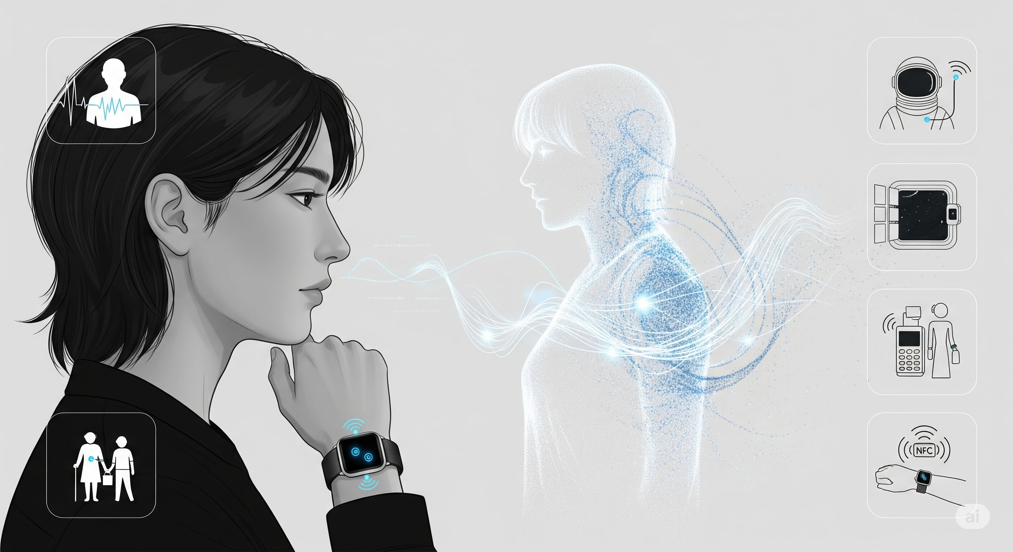
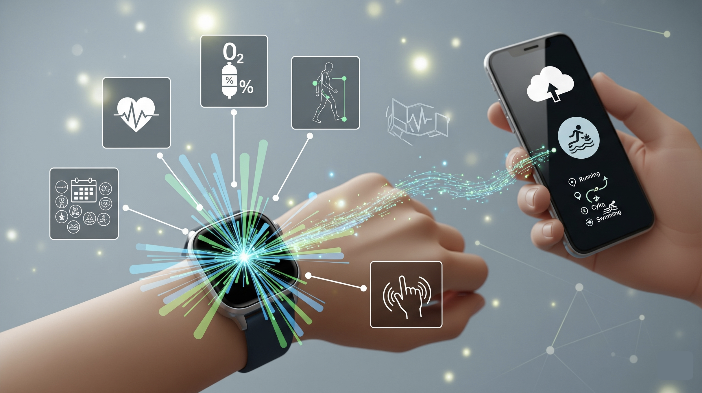
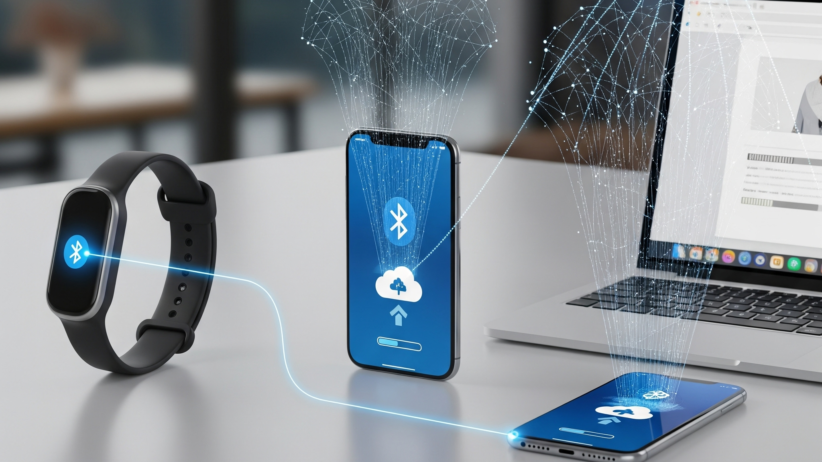
Data Wearables Collect
Biological Digital Twin
Notes:
Modern wearables don’t just count steps or calories. They track heart-rate, oxygen levels, how we walk, menstrual cycles, tremors, GPS trails, and our proximity.
Piece by piece, the wearables build a real-time digital twin of our body, feelings, behaviour, and our whereabouts. The digital twin remains in sync with our physical reality every second we choose to wear a smart device.
In clinical, disability, aged care, and space exploration settings, a real-time biological digital twin is immensely helpful. Continuous monitoring can spot emerging conditions before we feel them. In some cases, this can prevent injury, reduce medical impact, or save lives.
In retail, wearable devices speed up payments and, when paired with biometrics, they can reduce payment scams and frauds.
But, if we pause and look at the diversity and enormity of our personal, biological, and physical wellbeing and weaknesses these devices and their makers collect… and share with a large number of third parties and Governments across the world – the privacy and safety risks start to dawn upon us.

Slide 3
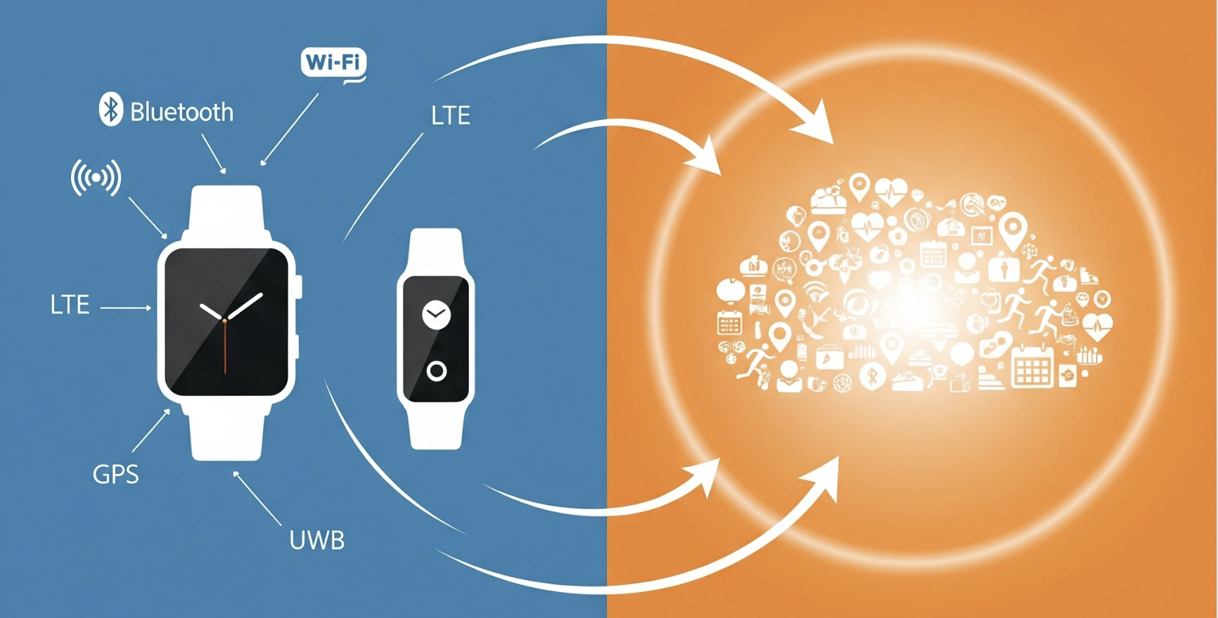
Risks
Notes:
For most reputable devices such as Apple, Fitbit, Garmin, Samsung, and clinical wearables, the answer to the obvious question - “Can our wearables be hacked? - is: not easily and doing so is not a good return on investment for malicious actors.
That’s because the reputed retail and clinical manufacturers build highly robust and secure hardware, and they keep the operating systems and firmware up to date. MFA helps with access control. Transmission over Bluetooth, Wi-Fi, or 5G is encrypted. The devices, the data stream, and the streaming channel are not where the real risks are.
The exploitable risks sit where our biological and location data is pooled at scale and stitched back into a real-time picture of our lives. The exploitable risks also sit in the third-party applications that we install on our wearables or share our data with.
The commercial ecosystem built around our biological data prioritises real-time access and analysis over our privacy and safety.
If we look at these third-party integrations and the centralised data store through a hostile lens, it’s a portal into millions of people’s bodies, daily routines, and real-life vulnerabilities.

Slide 4
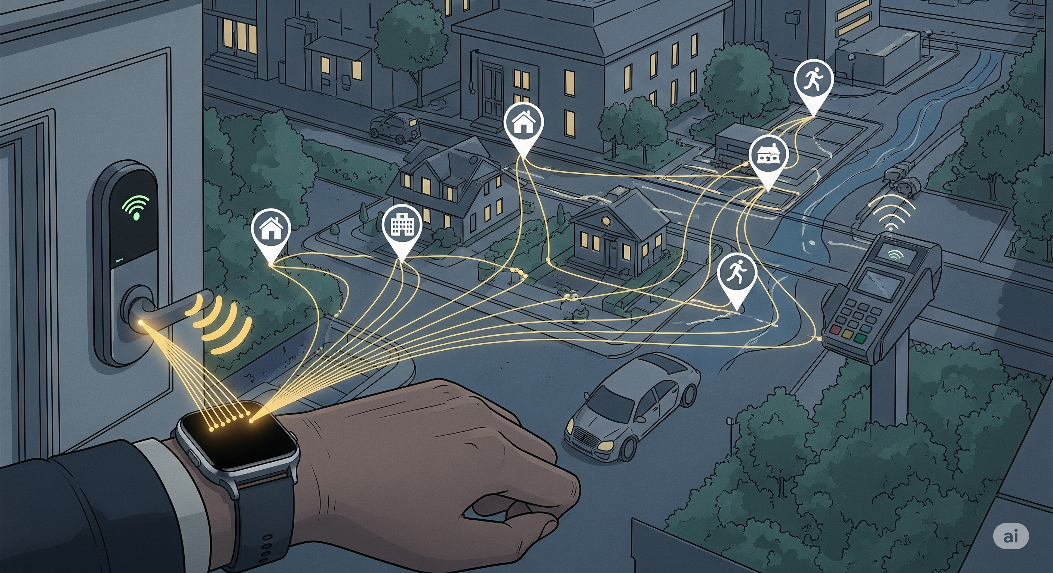
Physical Safety and Access
Notes:
Our wearables keep drawing the same lines on their maps — home, work, school, childcare, clinics, running tracks, defence bases, data centres, etc.
If a business or a malicious actor wants to create a real-time and accurate map of us, our loved ones, and what tangibly matters to us, centralised and real-time data stores like these are the greatest repositories to tap into.

Slide 5
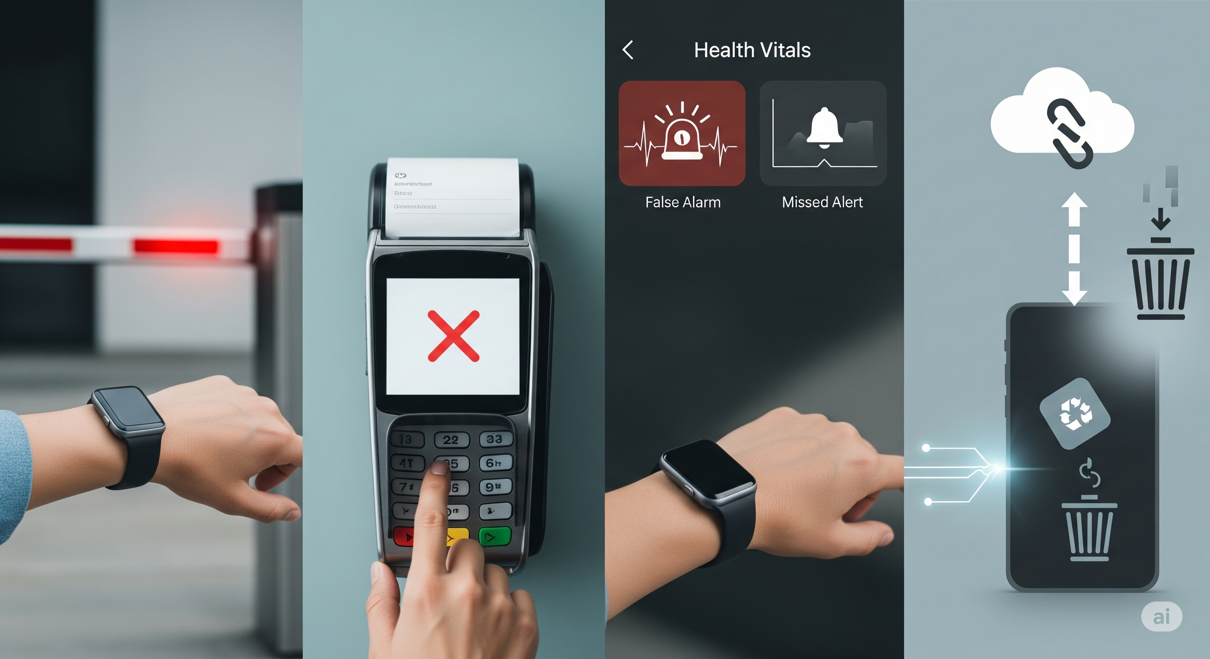
Account Takeover
Notes:
A compromised third-party app or data store can lead to a takeover of our accounts connected with our wearables, and this account takeover can compromise our safety in the real world.
It can strand us at a gate, block payments, make unauthorised payments, or silence critical alerts right when we need them. Stolen or spoofed signals from our devices can be relayed to unlock a home or a car. Shared health and location data can become a tool for stalking and coercive control in domestic abuse cases.
Sensor spoofing can trigger false clinical alarms, or worse, suppress real clinical alarms, tricking us into making bad decisions based on bad data.
Even if our accounts are never hijacked, there is another hidden risk. The long-term retention and analysis of our data create profiles that shape decisions about us without our knowledge or consent.

Slide 6
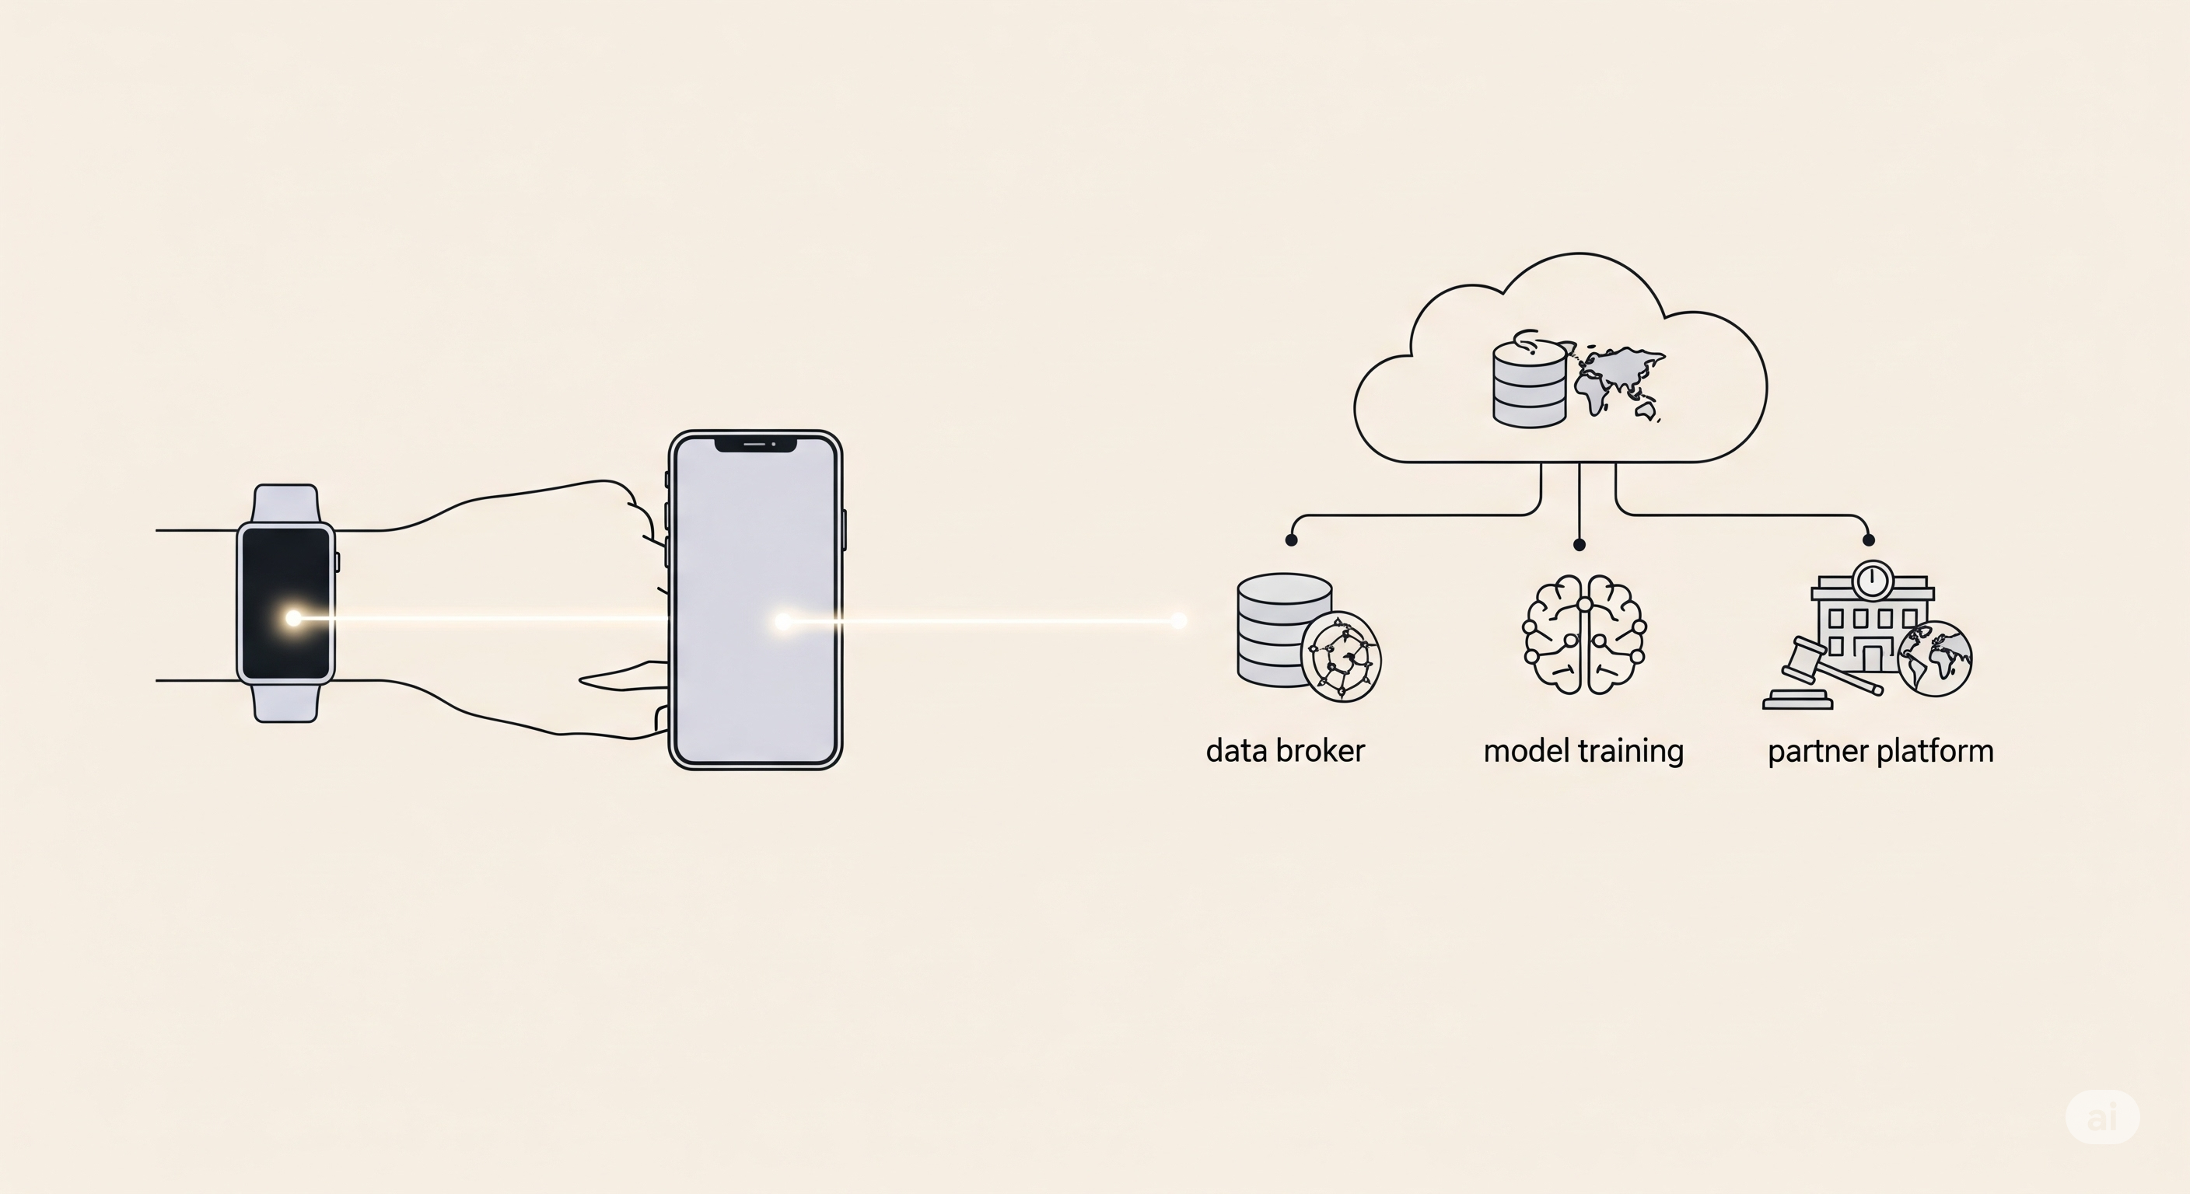
Profiling and Exposure
Notes:
Once our data lands with a third party, it stops working for us.
Data from wellness apps flow to insurance underwriters and are used to determine eligibility for certain insurance covers.
Electronic transactions, Wi-Fi logs, and ad IDs can stitch anonymous and de-identified data back to us, and in aggregation, can uniquely identify us for commercial or security profiling.
Data models train on our traces and assign scores that follow us around. In courts, at border controls - or after a merger, years of our personal, biological, location, and financial data can change hands without our consent because we accepted the T&Cs all those years ago.

Slide 7
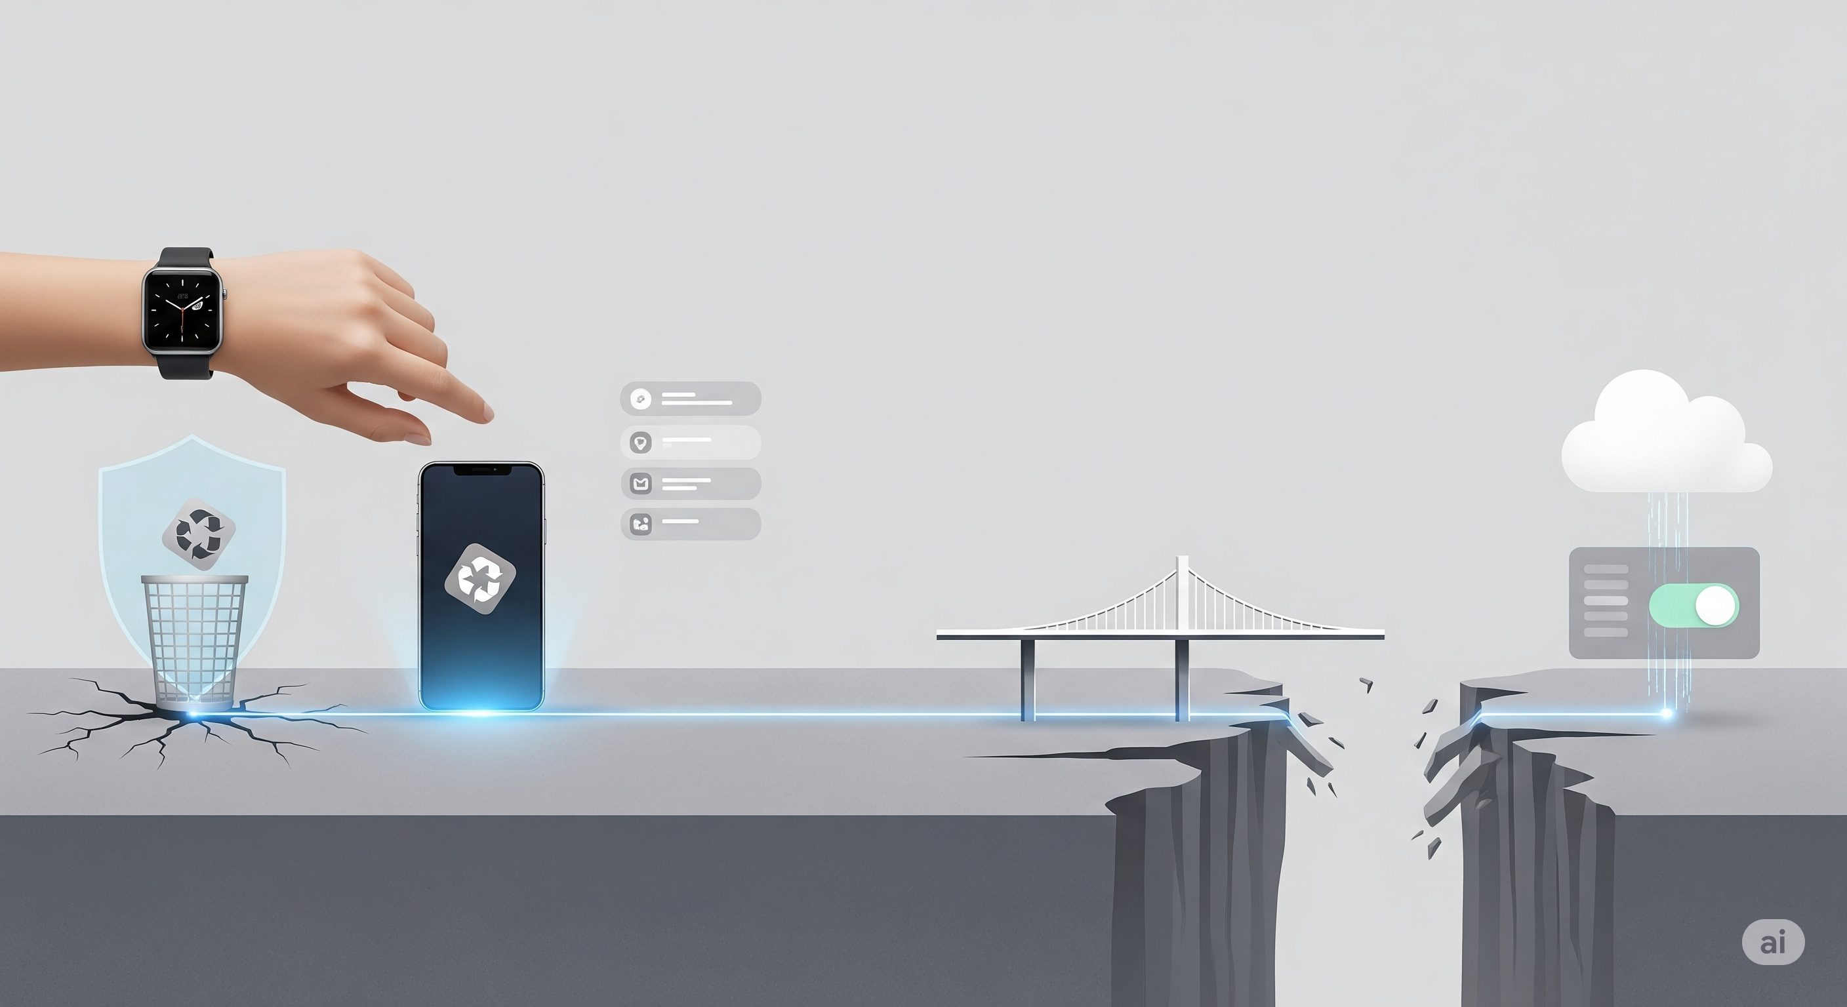
Perception vs Reality
Notes:
Part of the risk is perception versus reality.
We believe deleting a third-party mobile app stops the data sync from our wearables. In reality, the data keeps syncing unless we revoke access from within the mobile app of our Fitbit or Apple watch. Consent fatigue means most of us click allow or accept without fully understanding the second degree consequences of our choices.
Most businesses in this space do not have malicious intention, but our real-time biological data is what keeps these businesses profitable, thereby influencing their priorities.
We do have some choices, but they are often hidden, inconvenient, or time-boxed. Businesses get acquired, sometimes by foreign entities that may not have to abide by the laws of their consumers’ countries. Our data gets mixed up in legal investigations spanning global jurisdictions – thereby exposing us to state actors whose interests may be misaligned with ours.
Over time, the gap between what we believe is happening and what’s actually happening becomes too wide to close or undo.

Slide 8
KCD Framework
Know
Control
Decide
Notes:
Despite all the risks, the wearables offer undeniable utility. They encourage healthier habits, optimise training, make payments faster, and keep parents reassured about their kids’ whereabouts.
For someone with a heart condition, the alert from their smartwatch can mean getting to a hospital in time. For an aged-care nurse, continuous monitoring can mean catching a fall before it turns fatal. Rick Shearman, a Byron bay bodysurfer, and many others owe their lives to the emergency SOS function of their smart watches.
However, awareness and control still matter.
The KCD framework that I have tested in many spaces, keeps it practical:
Know: Open the Apple Health app and you’ll see data categories like heart rate, respiratory rate, cycle tracking, GPS routes, and even environmental noise levels. That data doesn’t just sit there. By default, it can flow into apps like Strava, MyFitnessPal, Vitality, or Headspace if permissions are left unchecked. Strava keeps our activity history indefinitely unless we delete it manually.
Knowing means auditing those permissions — app by app — and checking retention policies.
Control: Deleting the Qantas Wellbeing app does not stop Fitbit data being shared with Qantas. We also need to revoke Qantas Wellbeing's access to our Fitbit data to actually break the data sync.
Control means tightening things at the source: turning on passkeys for the Garmin Connect account, switching on MFA in Samsung Health, and removing integrations (not just apps) we don’t actively use.
Decide: Not every device gives us meaningful control. Some budget fitness trackers bury their terms in vague privacy policies, with no way to revoke access once data is uploaded, no clarity on where or how long it’s kept, and no named partners. In contrast, Apple publishes a clear data deletion process through its Privacy portal, and Garmin lets us export and permanently delete our data from Garmin Connect.
Decide means weighing those differences and walking away from devices that can’t meet a basic standard of transparency and control.

Slide 9
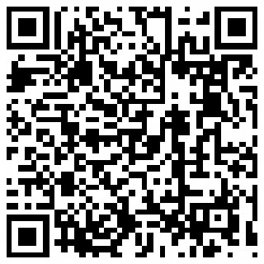
THANK YOU
Gaurav Vikash
Don’t use what we can’t understand or control.
Notes:
We must not be casual with a living dataset that reaches into our bodies, our homes, and our lives. We must carefully choose what to use, and we must be mindful of the second degree consequences of our choices.

Slide 10
Know | Learn the data flow from the device, all the way to vendor cloud and its partners, and potential risks along the way. Verify security basics - hardware security, connection security, passkeys or MFA options, transparent release notes, update cadence, breach history, data storage location, privacy policy, etc. Dependency on the device and connectivity: Does the device work offline, and can we switch devices without losing history if we lose or damage the device?
Control | Lock access first — enable passkeys or MFA, unique email alias per account, disable social logins, do not pair in public places Minimise inputs — turn off sensors and data types we don’t need, remove background location, limit Bluetooth advertising, disable microphone access unless required Govern connections — link only the essentials, review third-party integrations quarterly Plan for degraded mode — mirror critical alerts to SMS, keep a physical key for doors and cars that rely on presence, carry a fallback payment card
Decide | Apply hard lines - If we cannot stop a data sync with a third-party app, we won’t purchase the device. If the device maker shares our data with unnamed or overseas partners, we won’t purchase the device Conduct regular review: quick monthly glance at connections, deep quarterly audit of permissions, integrations, exports, and retention
Notes:
Detailed KCD

