Slide 1
Cyber Security in Space Securing the Stars and Our Future
Gaurav Vikash
Notes:
Ladies and gentlemen, a very good afternoon to all of you. Hope everyone is having a great conference. I realise there are many parallel presentations by some fascinating speakers, thank you, for choosing to join this presentation.
While you are welcome to take photos of slides you find insightful, the QR code on the last slide will help you download the whole presentation, along with notes. So, sit back and enjoy this presentation.

Slide 2
AGENDA
The Future
The Present
Context
Vulnerabilities
Resources
Collaboration
Australia’s Challenges
Conclusion
Notes:
This talk will present the most likely future of our “space”, specifically focused on the promises and disasters this future will bring, and how a very small set of countries are far ahead of the rest of the world in ensuring their place in this future.
We will walk through some small to large scale exploitations of satellites to demonstrate that space cyber warfare is not just a thing of the sci-fi movies. With large companies and nation states engaged in a fierce satellite race, it’s prudent that we dig our heads out of the sand and prepare ourselves for the future that awaits us.
We will briefly explain some of the concepts and nomenclature to set context for exploring some misplaced assumptions about satellite’s cyber security. We will then dive deep into understanding various cyber vulnerabilities Low Earth Orbit satellites are exposed to, and how some of those are more severe than the others.
Finally, we will discuss the academic and collaborative resources available to us to bridge our knowledge, research, and preparedness gaps.

Slide 3
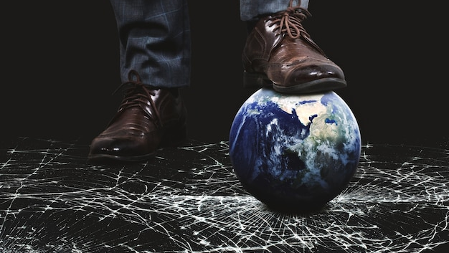
THE
FUTURE
Notes:
As we trample on Mother Earth, wage wars against innocent civilians, cancel voices of reason, we ought to take a pause and think about the inheritance we’re leaving for our kids. Makes my heart ache

Slide 4
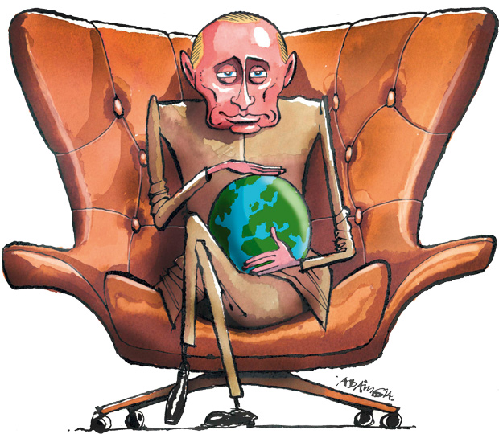
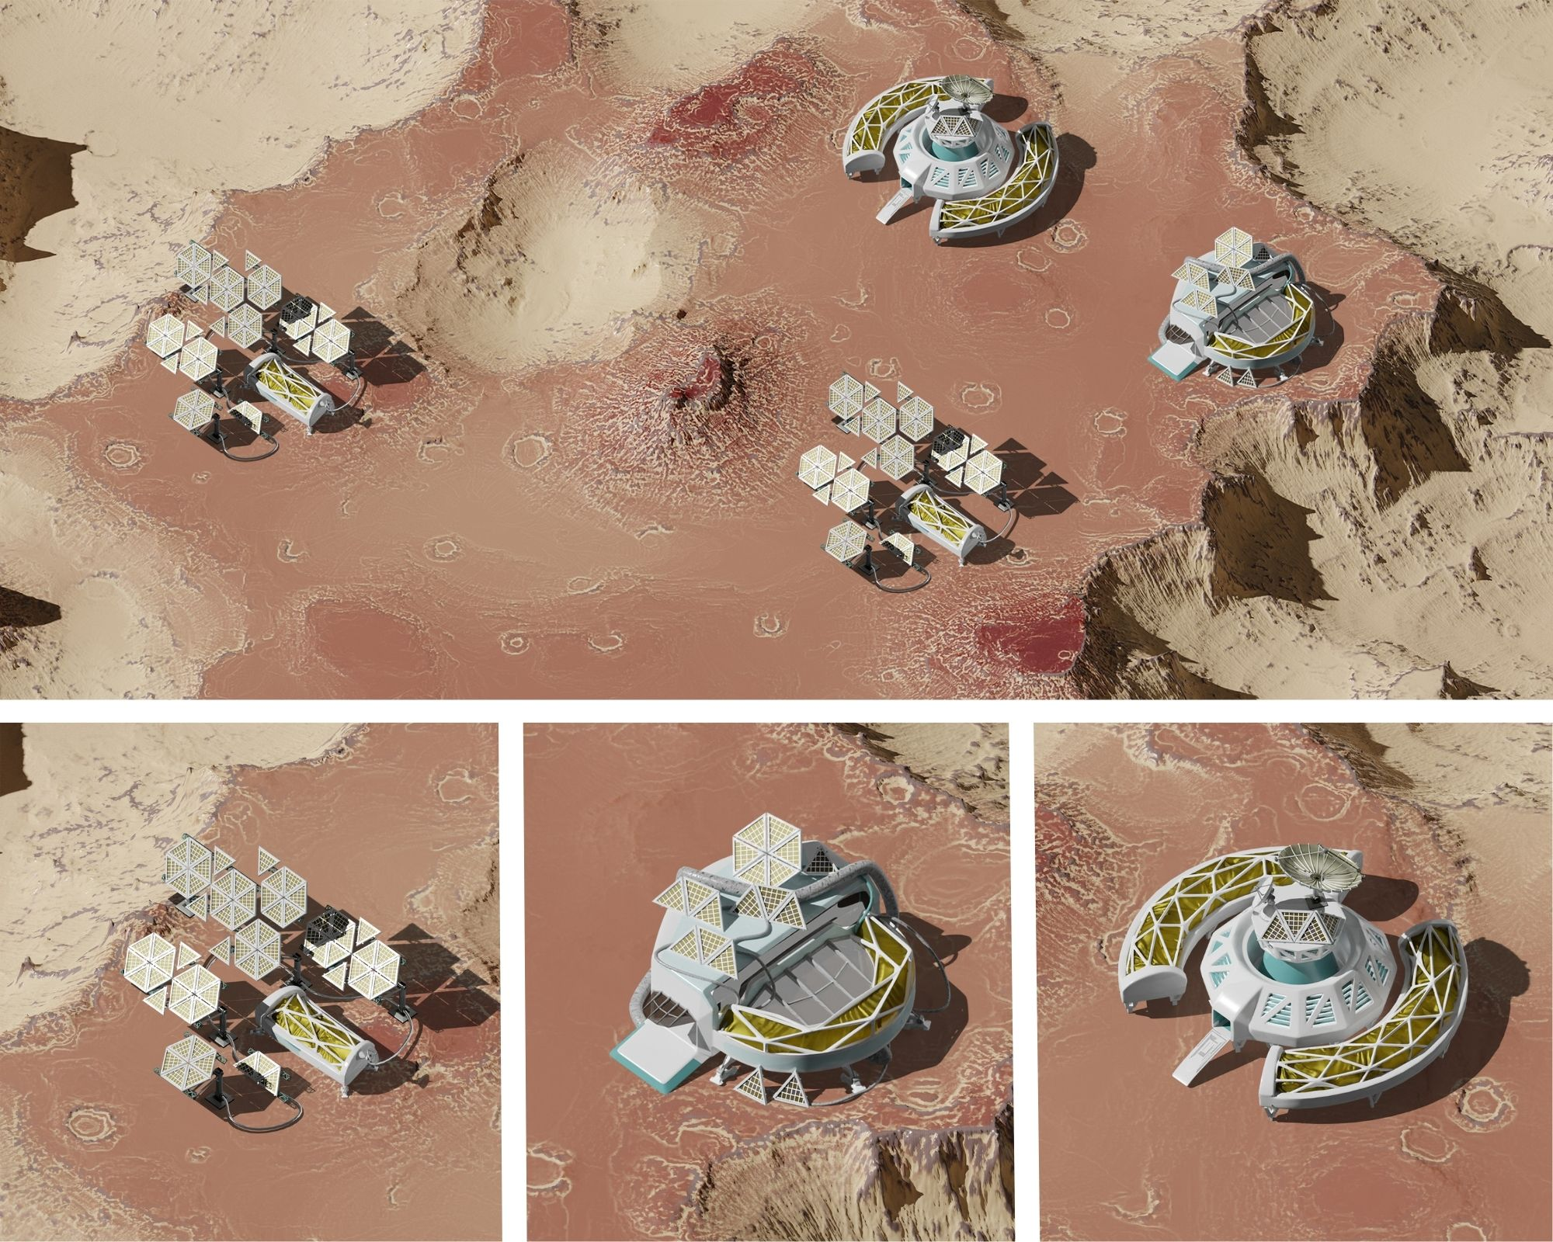
MOTIVATION
Notes:
What do quintillions of dollars, promise of world domination, and a safe new planet have in common?
A ruthless space race with very few competing countries holding the future of our Universe (not just the earth) in balance.

Slide 5
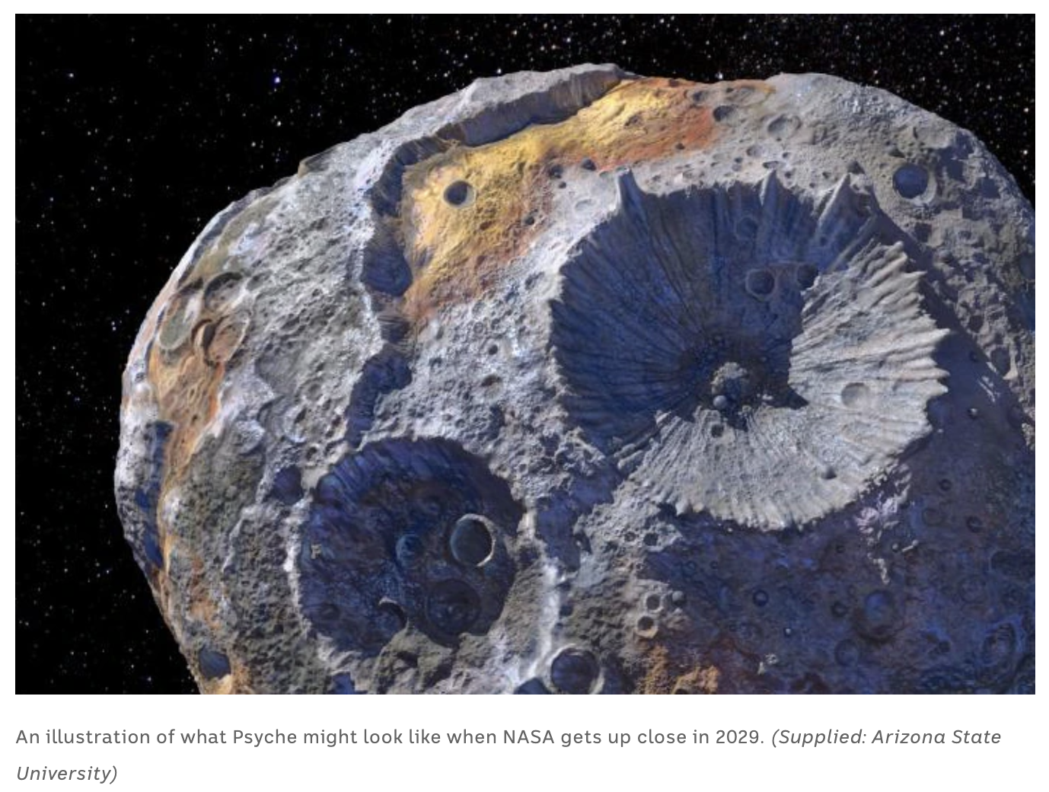
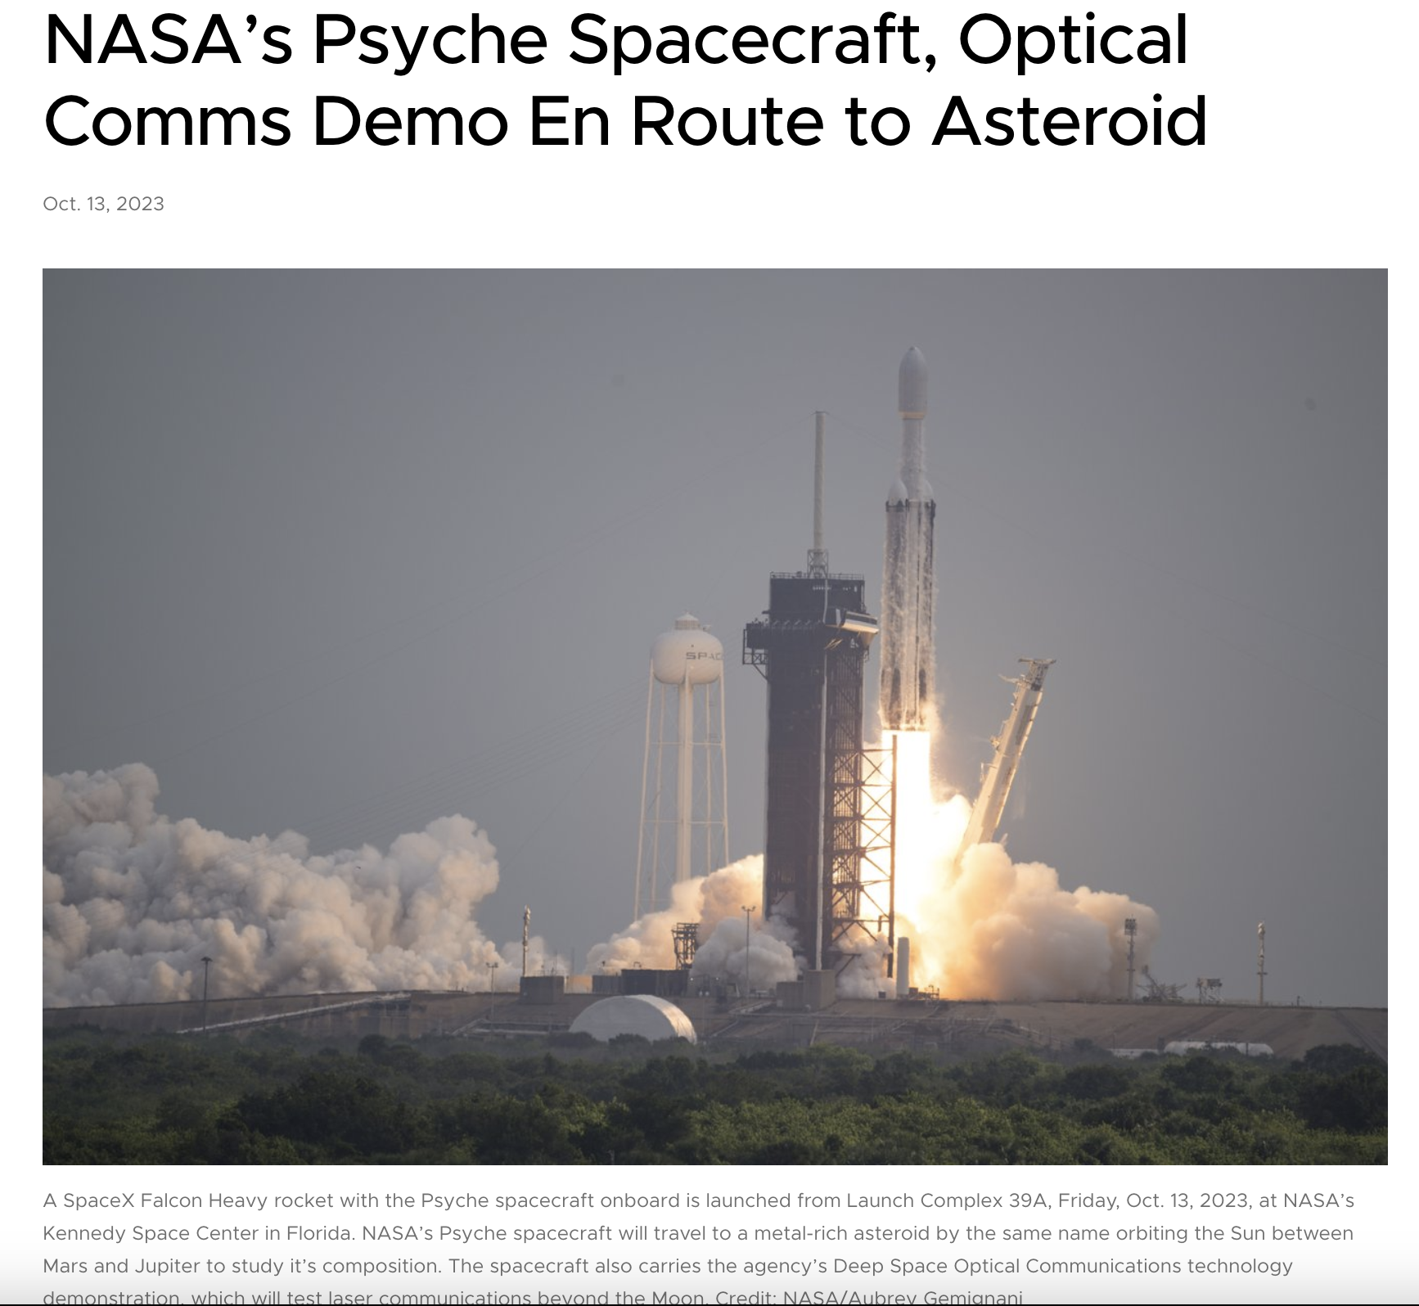
UNFATHOMABLE RICHES
16 Psyche USD $90b pp
Notes:
In the swirling ring of asteroids between Mars and Jupiter, one space rock has attracted far more attention than any other. It's known as 16 Psyche.
16 Psyche contains over 700 quintillion dollars' worth of precious metals. If equally divided, that’s almost USD $90b for every human being on Earth. NASA with support from SpaceX, and other space agencies like NASA are already racing to this asteroid.

Slide 6
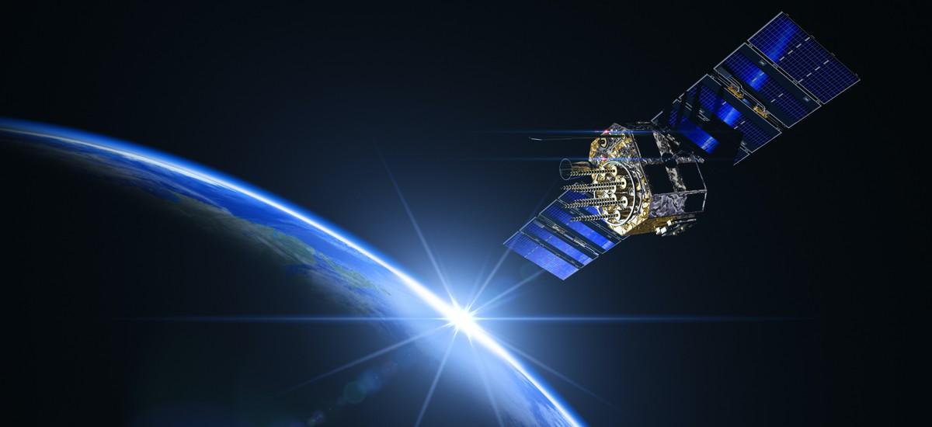
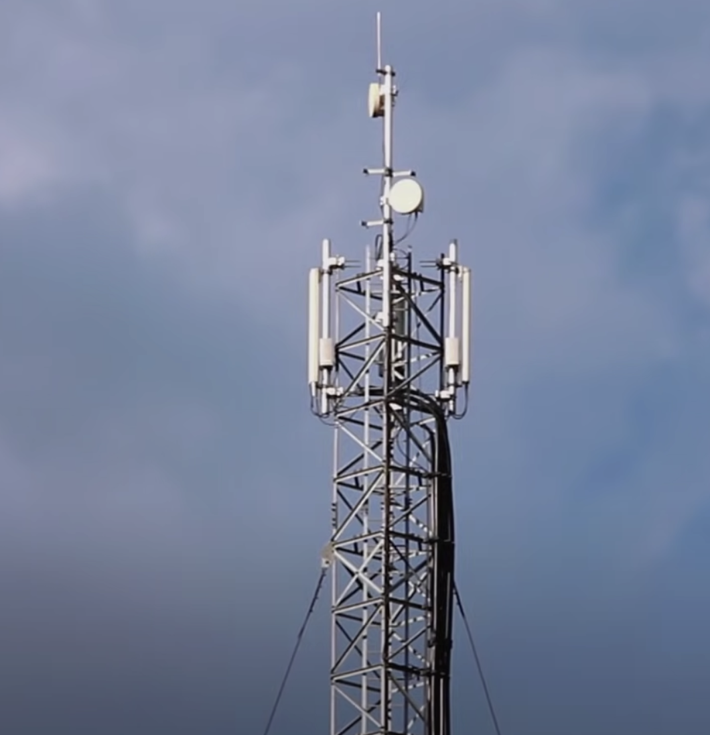
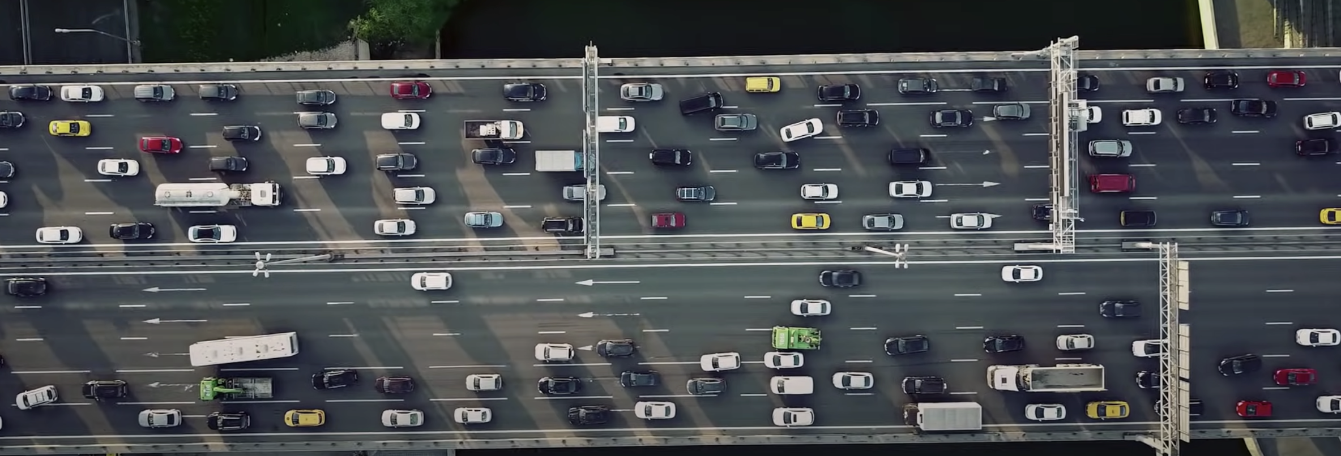
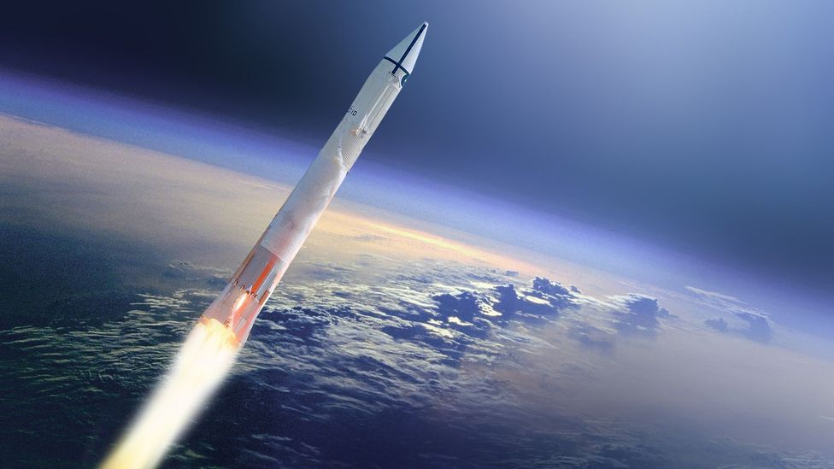
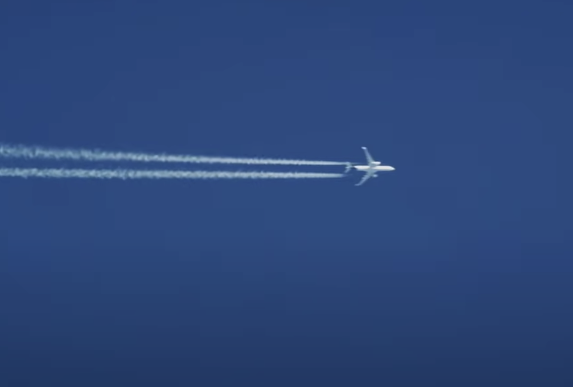
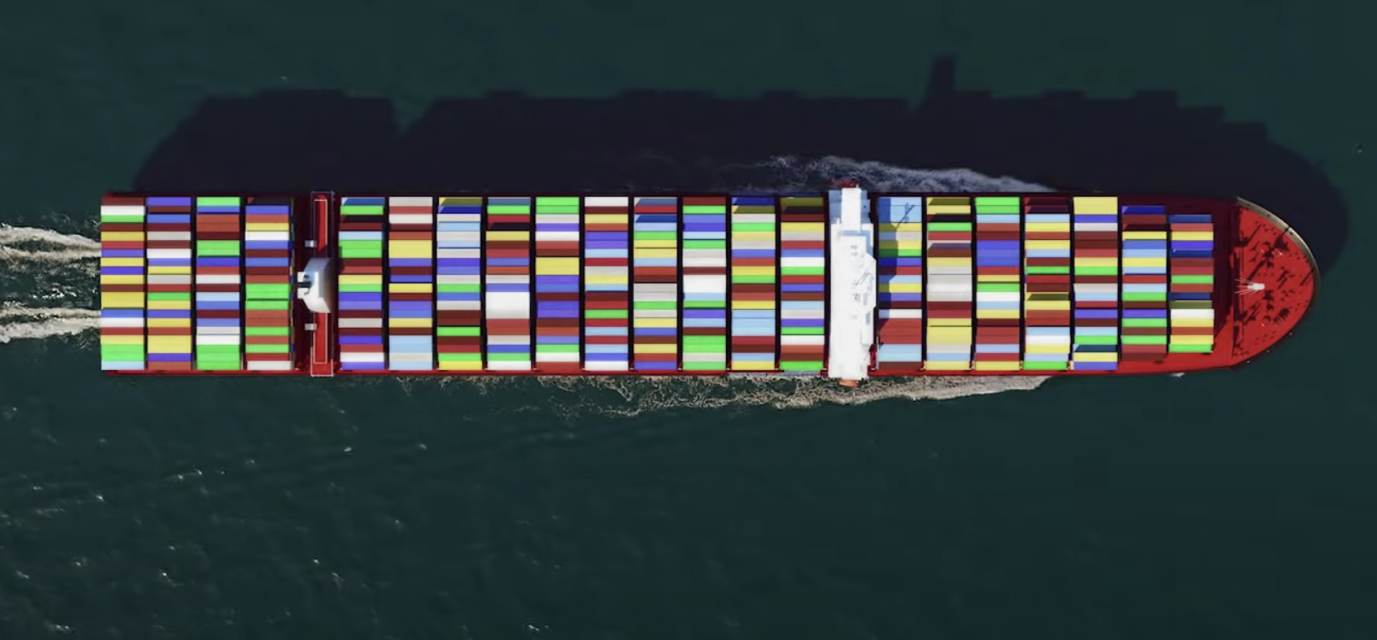
WORLD DOMINATION
Notes:
Controlling the satellites is already a key instrument deployed to wage global wars, which aren’t always fought conventionally on the battlegrounds.
Wars involve compromising critical infrastructure, blocking crucial communication and supplies, misdirecting enemy planes and missiles, and ultimately breaking citizens’ morale.

Slide 7
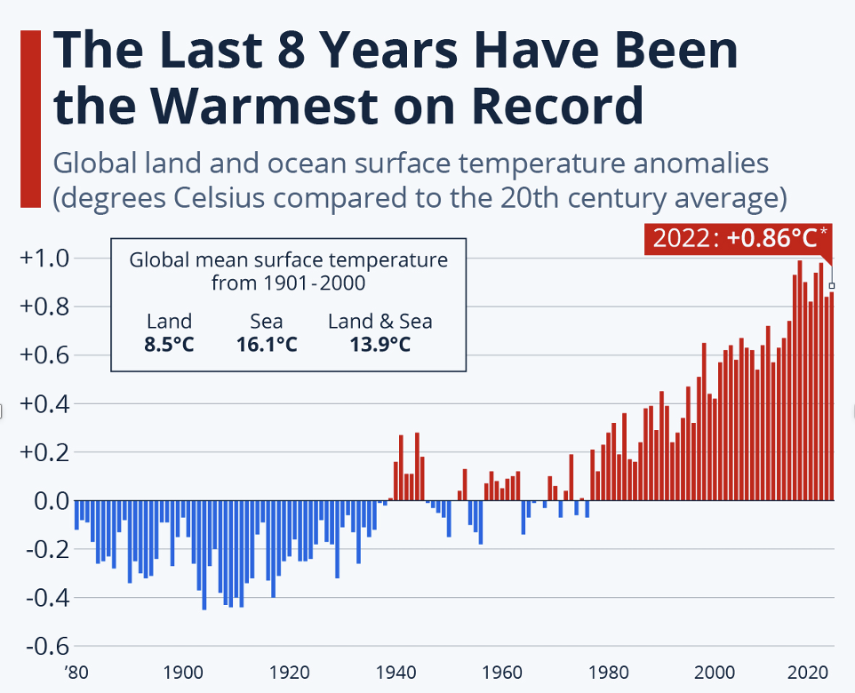
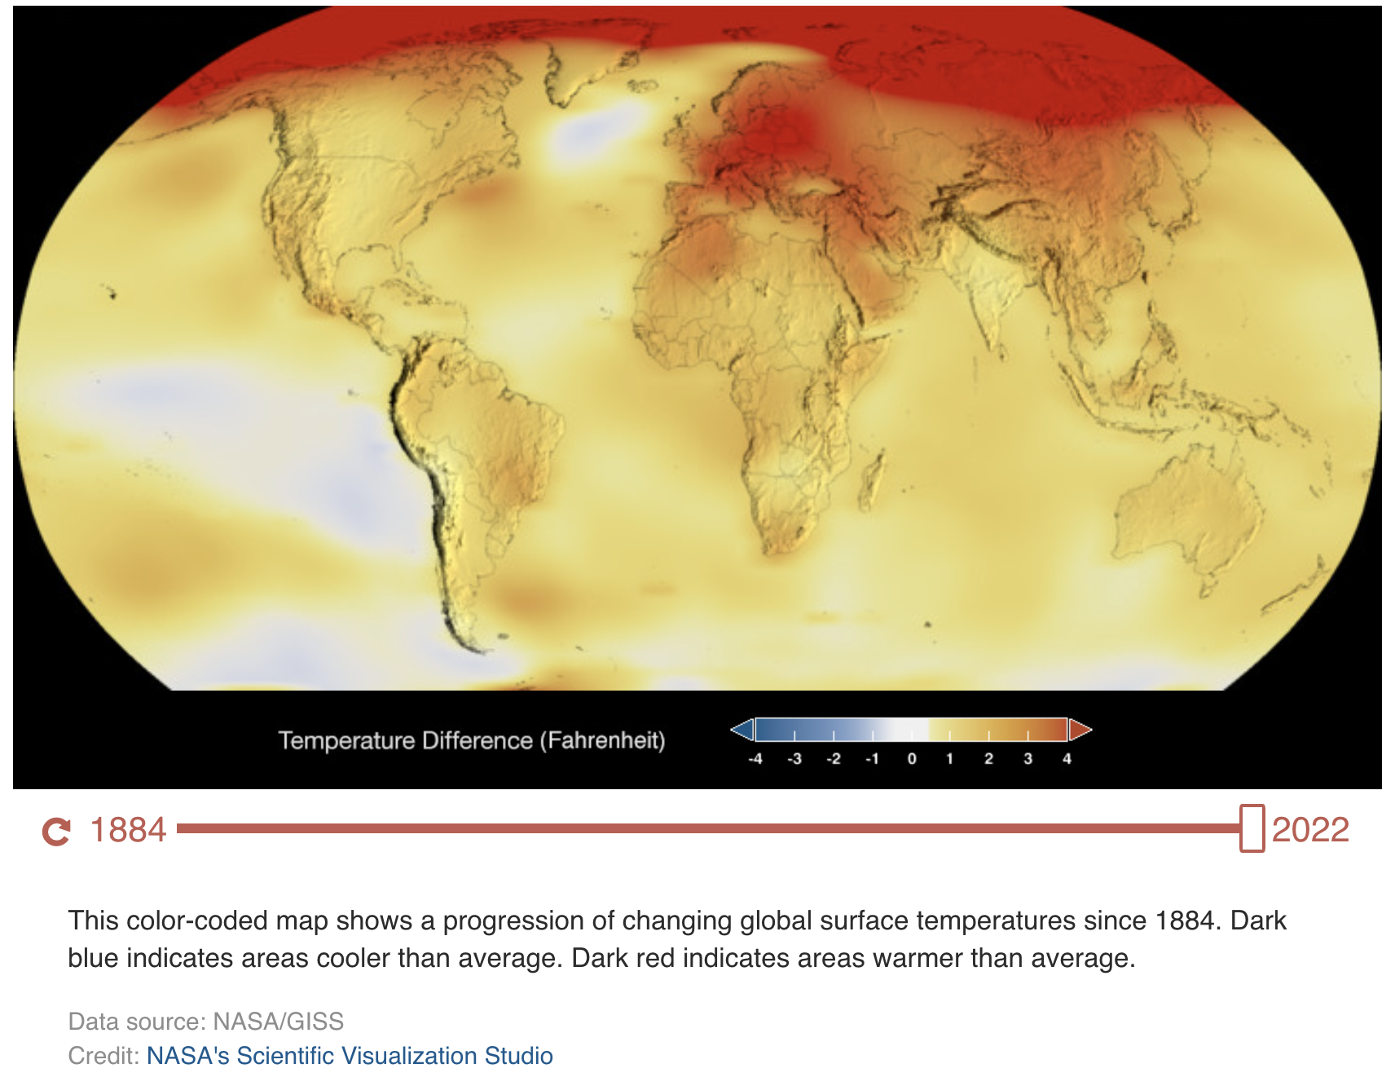
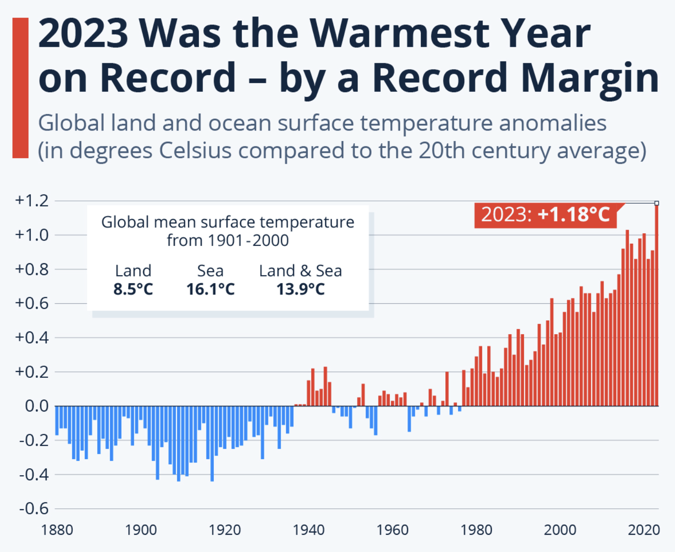
SAFE (CONTROLLED?) NEW HABITAT
Notes:
2023 heat pushed the global average temperatures 1.5℃ above the pre-industrial average. 2023 was the hottest year since 1850. The 10 warmest years since 1850 have now all occurred in the past decade
We are causing irreversible damage to the Earth’s atmosphere and will need a new habitat in the near future.
Do you think the powerful nations and companies need any more motivation to try and dominate this satellite race?
https://www.statista.com/chart/28722/global-surface-temperature-anomalies/

Slide 8
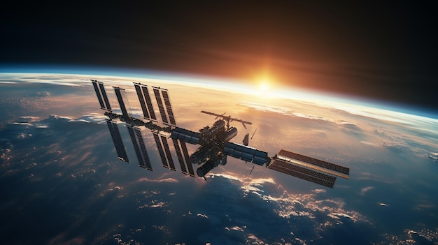
THE
PRESENT
Notes:
A lot of this seems like stuff of sci-fi movies or in the future. The reality is, all of this has been happening for ages.
Who here has watched the movie ”The Usual Suspects”? I can never forget its last monologue “The biggest trick the devil ever pulled was making everyone believe he didn’t exist.”

Slide 9
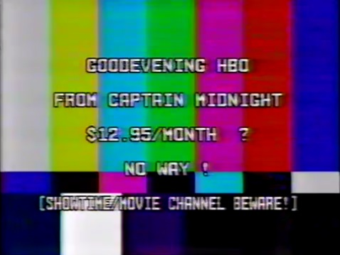
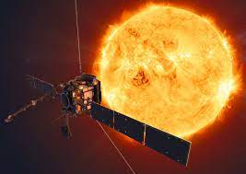
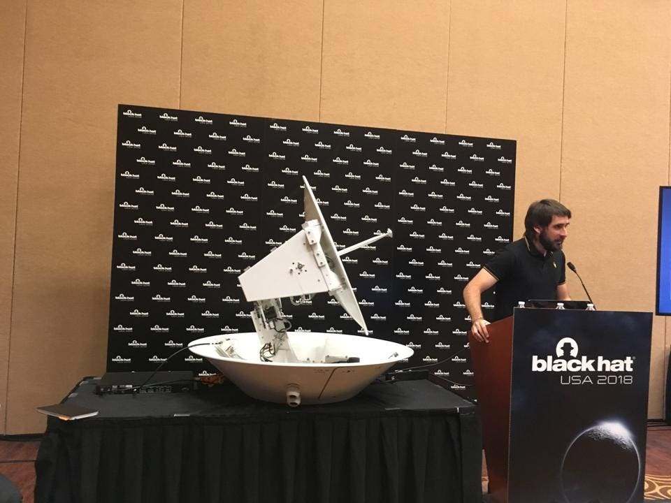
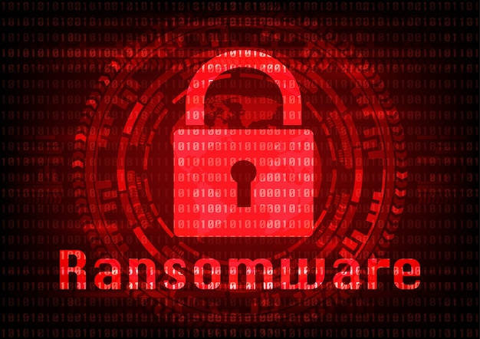
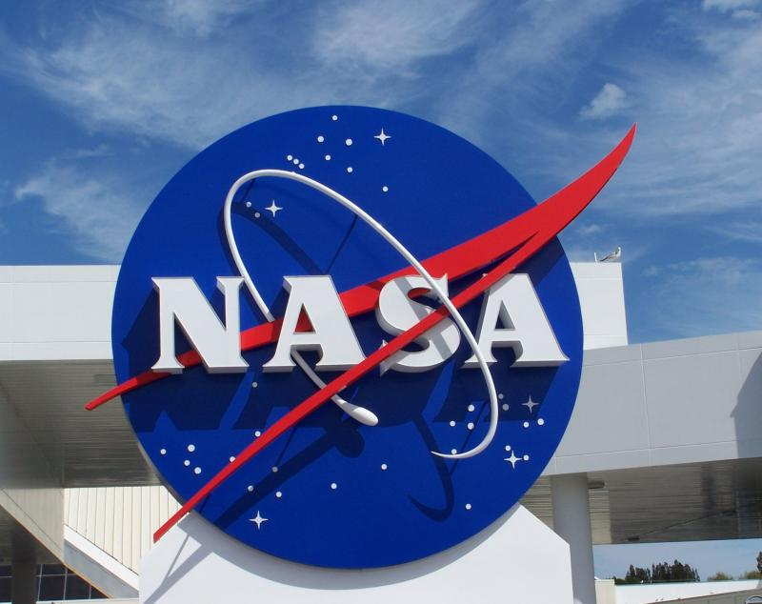
NOT
NOVEL
Notes:
Cyber attacks on Satellites are not new
In 1986, a man going by “Captain Midnight” jammed HBO’s feeds because he was mad about paying a higher fee. https://en.wikipedia.org/wiki/Captain_Midnight_broadcast_signal_intrusion
In ‘98, hackers compromised the computers at the Goddard Space Flight Centre in Maryland and gained control of the American-German ROSAT X-Ray satellite. They gave the satellite the order to point its solar panels squarely at the sun, destroying its batteries in the process and rendering the satellite inoperable. https://www.space.com/13356-falling-german-satellite-rosat-death-dive.html
In ‘99 hackers took over the UK’s SkyNet satellites. https://content.time.com/time/magazine/article/0,9171,20673,00.html
In 2018, Ruben Santamarta, a researcher was able to spy on hundreds of commercial and military planes due to vulnerabilities in satellite communications equipment. All for academic research though. https://www.forbes.com/sites/thomasbrewster/2018/08/09/this-guy-hacked-hundreds-of-planes-from-the-ground/?sh=16fb27ba46f2
In 2019, hackers breached NASA and stole Mars mission data. The infiltration was only spotted and stopped after the hackers roamed the network undetected for almost a year. New devices added to the network weren’t always subject to a vetting process, and the agency didn’t know the gadget was present on the network. https://www.welivesecurity.com/2019/06/24/nasa-breach-mars-raspberry-pi/

Slide 10
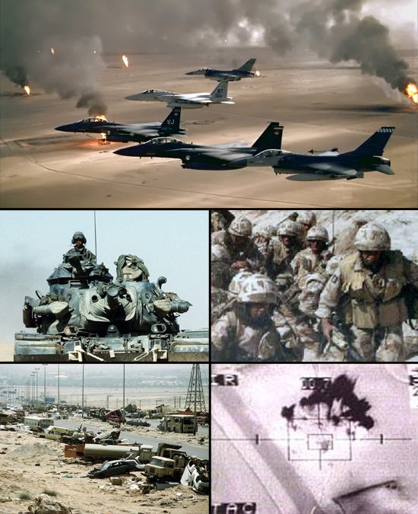
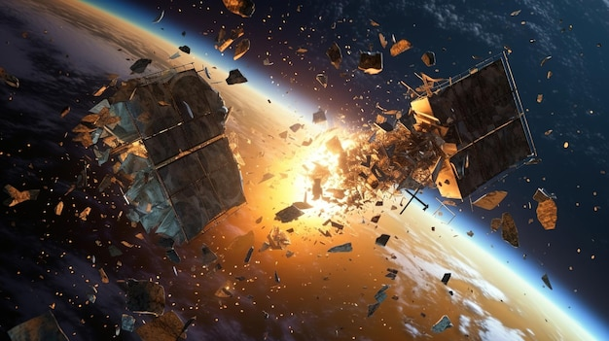
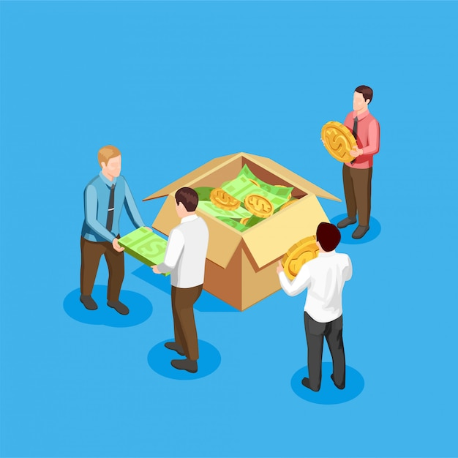
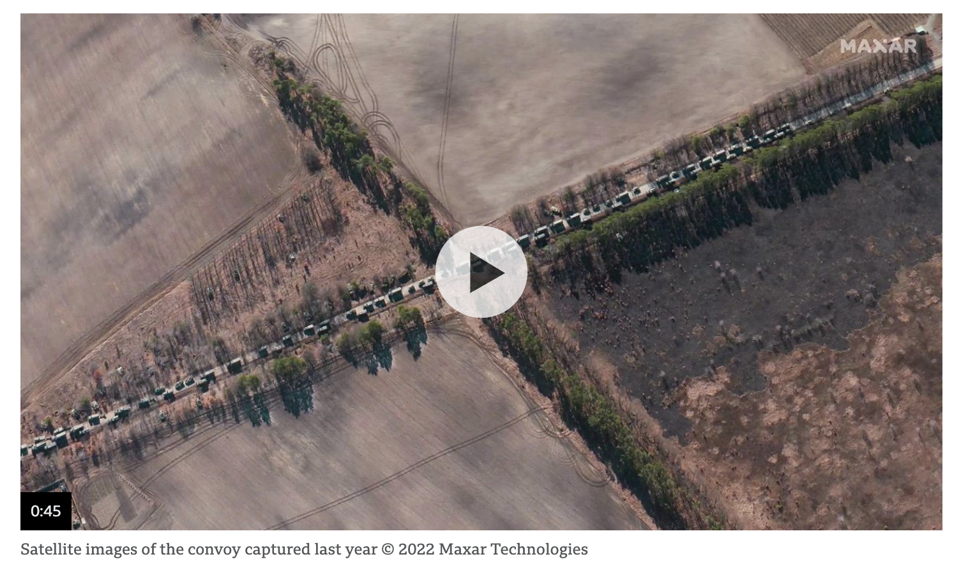
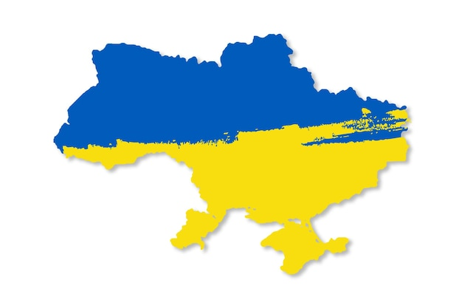
SATELLITE WAR
Notes:
The ‘91 Iraq war is known as the world’s first "Space War”. Although the actual fighting did not take place in the upper reaches of the atmosphere, GPS played a critical role in the Coalition’s rapid dismantling of Iraqi military.
In 2021, Russia launched a test missile and blasted one of its own large satellites into hundreds of pieces of debris. The U.S., China, India and Russia have all carried out similar ASAT tests in the past, creating space junk in the process.
The Russia – Ukraine war started with Russia breaching and taking down the Ukrainian satellite communications provider Viasat. The impact wasn’t limited to Ukraine though, there were collateral damages. Across Europe and North Africa, tens of thousands of internet connections in at least 13 countries were impacted.
Same day, a private American satellite company called Maxar released a satellite image showing Russian troops lined up along the road in columns near Belgorod. A quick search for the routes this column might take to move toward Ukraine revealed the 40 kilometres of Russian convoy stretched from the Russian city of Belgorod to the Ukrainian border. Wouldn’t be the first instance of a private company getting involved in an international war without any consequences
Soon afterwards, Google temporarily turned off live traffic updates in Ukraine
Private companies like Capella, Maxar, Planet, Google and others wield too much power through accumulation of global satellite imagery. They may be biased in sharing information given that they may have military contracts with specific countries
https://www.wired.com/story/ukraine-russia-satellites
https://www.bloomberg.com/news/newsletters/2023-03-01/satellite-hacking-is-a-big-and-little-understood-cyberwar-threat#xj4y7vzkg

Slide 11
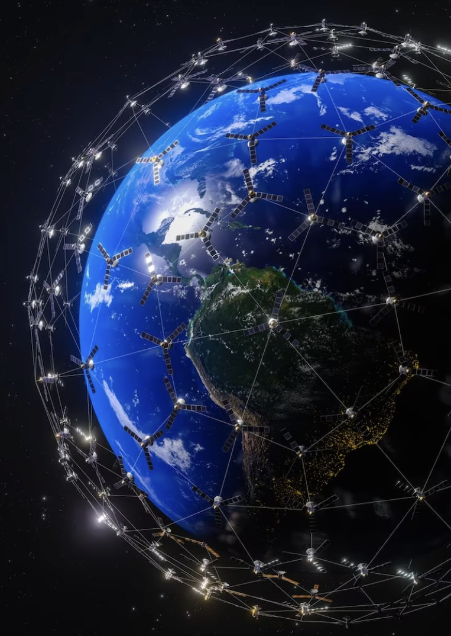
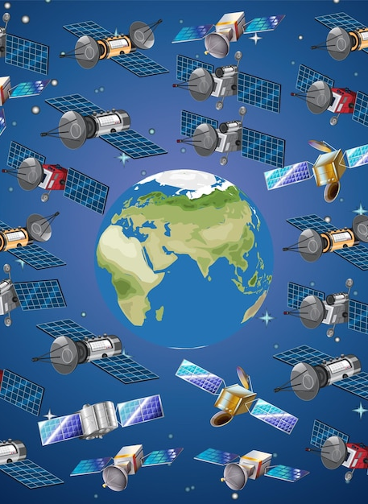
SATELLITE WAR
Notes:
Since the first Starlink satellites were launched in 2019, SpaceX has put more than 2,300 of them into low-Earth orbit, and the company plans to send up to 42,000 satellites into space to form a gigantic mega-constellation. We should be concerned by the potential military capabilities of the constellations, which can be used to track hypersonic missiles; dramatically boost the data transmission speeds of U.S. drones and stealth fighter jets; or even ram into and destroy other countries’ satellites.
China is also looking to compete with Starlink directly through the launch of its own satellite network called Xing Wang, or Starnet
In 2016, foreign hackers attacked the systems of Newsat, a small Australian satellite company that had planned to launch two satellites and boost the Australian satellite industry. The attackers left the network utterly corrupted, leading in part to the company’s liquidation. It was reported that the attackers had been inside the network for two years, spying on the company’s activities and Newsat had its head buried in the sand. https://www.abc.net.au/news/2016-08-29/chinese-hackers-behind-defence-austrade-security-breaches/7790166
https://airpower.airforce.gov.au/blog/BP27207741

Slide 12
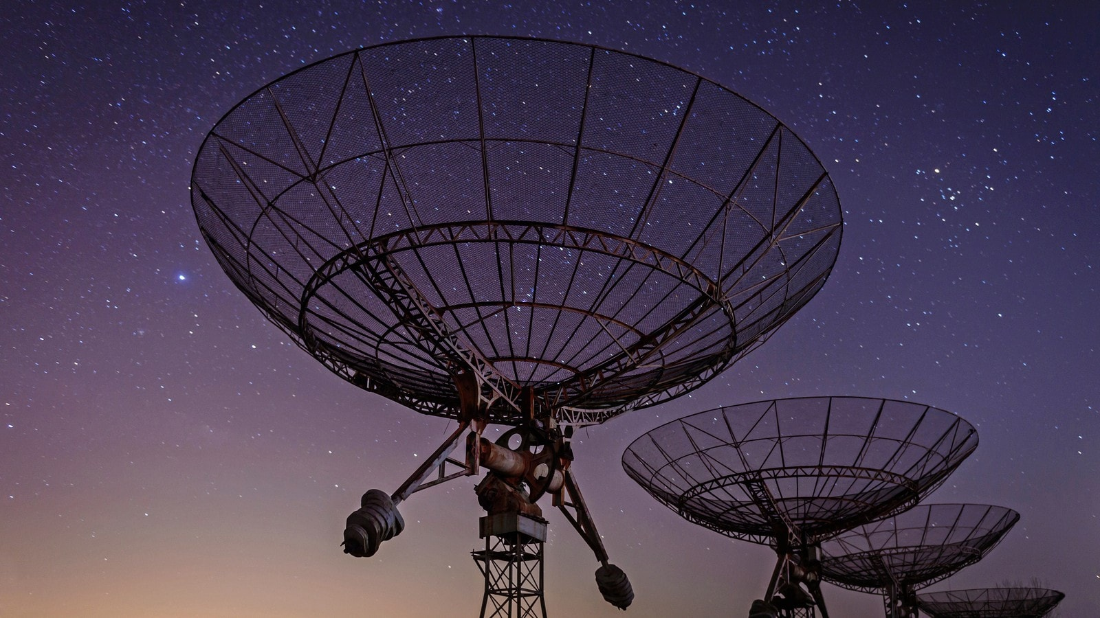
CONTEXT
Notes:
This devil definitely exists. Let’s take a step aside and try to realise our dependency on the Satellites

Slide 13
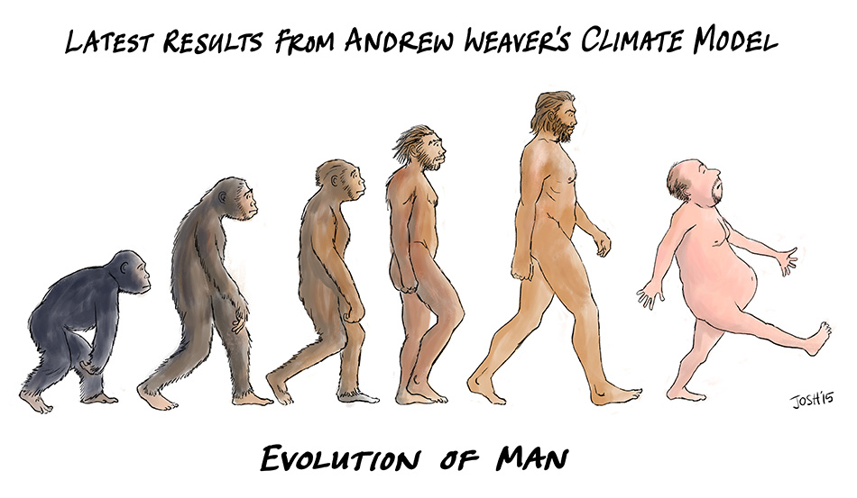
APPLICATIONS
Telecom
GPS
Aviation
Missiles,
Nuclear Missiles
Observation
Research
Technology
Notes:
We all know Satellites form the backbone of many essential applications. Humanity would go back about 70 years without satellites.

Slide 14
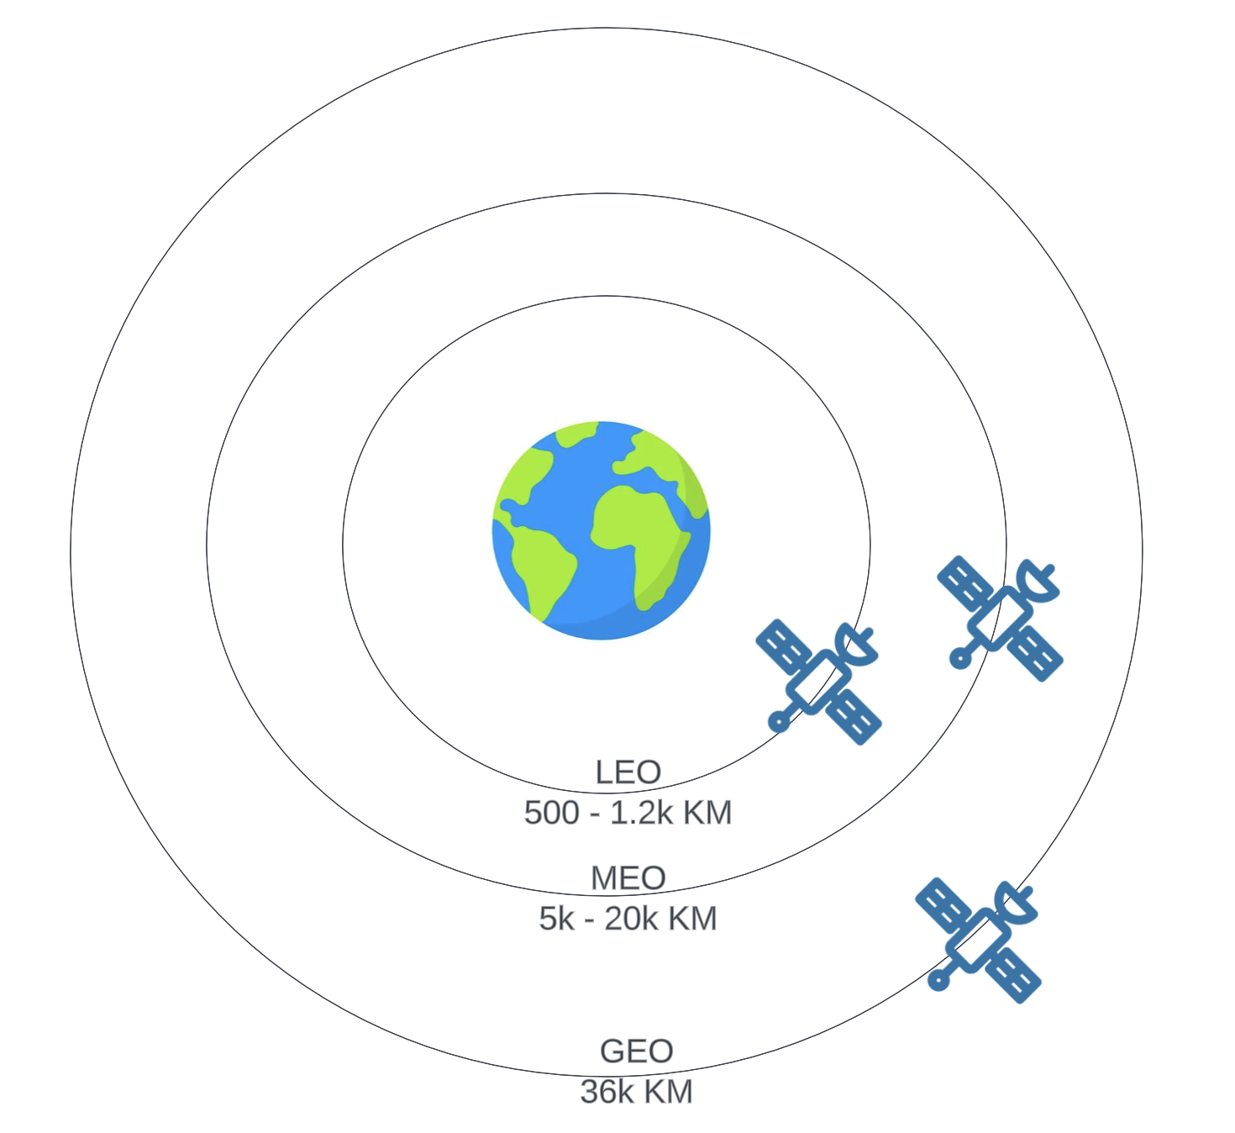
SATELLITE ORBITS
* Graphics not to scale
Notes:
Satellites revolve around the earth in 3 main orbits – Low Earth, Medium Earth, and Geostationary earth orbits.
Low earth orbit extends from 500 to 1,200 Kilometres above earth,
Medium earth orbit from 5,000 to 20,000 Kilometres and
Geostationary orbit is located at 36,000 kilometres above the earth.

Slide 15
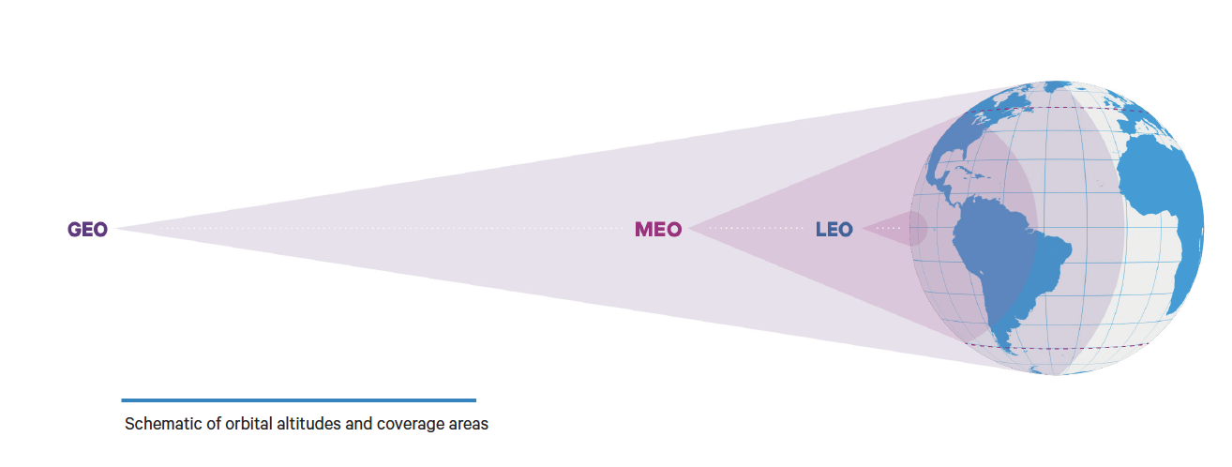
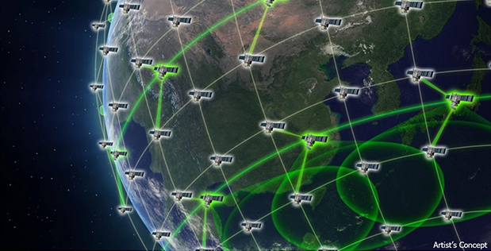
SATELLITE ORBITS
Notes:
LOW EARTH ORBIT is densely populated with thousands of satellites in operation today, primarily addressing science, imaging, and low-bandwidth telecommunications needs.
MEDIUM EARTH ORBIT is used for GPS and other navigation applications.
GEOSTATIONARY EARTH ORBIT satellites match the rotation of the Earth as they travel, and so remain above the same point on the ground. Hundreds of geostationary satellites deliver weather data, broadcast TV, and some low-speed data communication.
More recently, MEO constellations have been deployed to deliver low-latency, high-bandwidth data connectivity to service providers, government agencies, and commercial enterprises. MEO satellites bring fibre-like performance to remote areas where laying fibre is not viable, such as cruise, commercial maritime, aero, offshore platforms, network backhaul in difficult terrain, and humanitarian relief operations.
https://www.satellitetoday.com/content-collection/ses-hub-geo-meo-and-leo

Slide 16
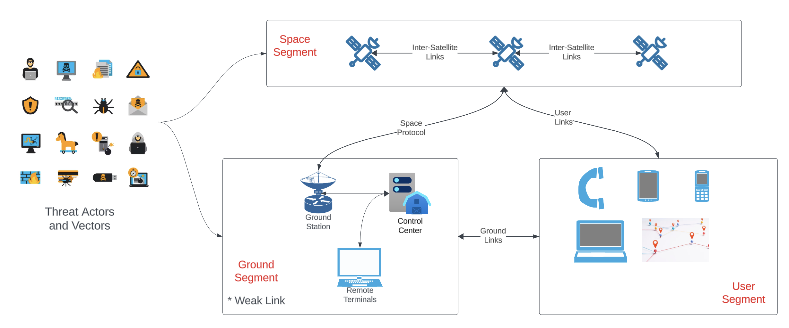
TERMINOLOGY
Notes:
Space systems are generally defined to consist of five segments: space, launch, ground, link, and user. For this presentation, we will focus on Space, Ground, and User segments.
The space segment consists of various satellites which communicate with each other over Inter-Satellite Links. At the most basic level, ISLs transmit information at high speed to any satellite in the constellation, rather than mission data or commands being siloed in one satellite. Equipping each node to send and receive data, reduces the waiting time for a satellite to be in range of a ground station and gives operators more options to task a satellite closest to a downlink location, which reduces latency. Same concept as highly available and local IT networks on the ground.
The ground segment is the ground-based infrastructure and associated services or support mechanisms and personnel critical to the functioning of the space system, such as satellite monitoring and control, uplink and downlink ground stations and mission operations Centres. Off all the space systems, the ground segment is the weakest link – we will explore more in the subsequent slides.
The User segment capabilities can be hand-held, or mounted in vehicles, on maritime vessels and in aircraft, e.g., GPS receivers, Starlink user terminals, satellite telephones.
The launch segment in a space system refers to the various components and activities involved in the process of launching a spacecraft from the Earth’s surface into orbit or beyond. This includes the launch vehicle, payload, ground support equipment, launch site infrastructure, and the procedures and personnel required to execute a launch.
The link segment is the communications network that connects the other segments and includes both the electromagnetic spectrum and cyber considerations. Note that the link segment includes ground to space, space to space, and ground to ground network connections.
https://www.kratosdefense.com/constellations/articles/inter-satellite-links-are-making-space-networks-a-reality
https://newspaceeconomy.ca/2023/02/02/space-system-segments-a-quick-overview

Slide 17
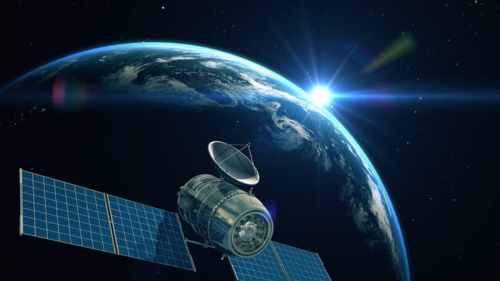
SATS ARE VULNERABLE
Notes:
A computer flying hundreds or even thousands of kilometres in the sky, at a speed of tens of thousands of kilometres an hour, is nonetheless still a computer.
And every connected computer has an attack surface.

Slide 18
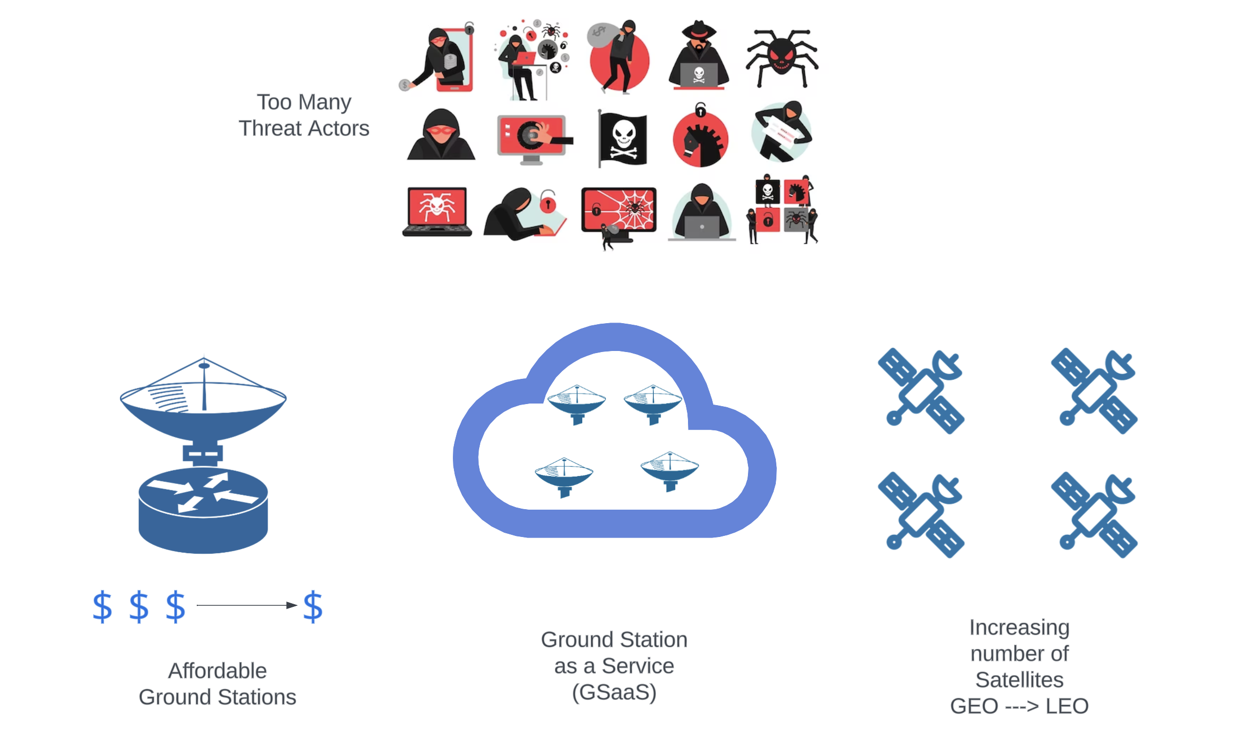
MISPLACED ASSUMPTIONS vs REALITY
Vast Distances
Limited Resources
Complex Tech
Lack of Motives
It’s different for Satellites
It’s different for “my” Satellites
Notes:
There are so many misplaced assumptions and perceptions we associate with cyber safety of the Satellites

Slide 19
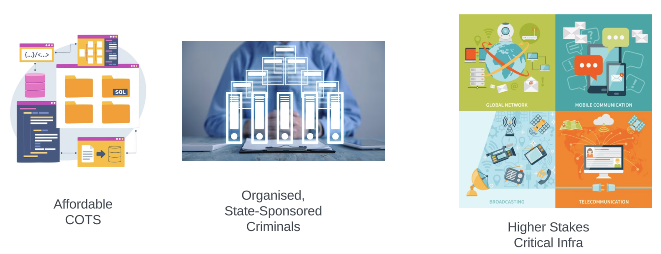
SECURITY BY OBSCURITY
No insight means No attack
Notes:
In more expensive and bigger satellites, you can imagine all kinds of very specialized, radiation-hardened hardware that is explicitly required when you go a lot further out into space. However, the majority of satellites occupy low earth orbit (LEO), where they are not so hardened or safe from cyber-attacks.
The computing hardware in low earth orbit is similar to embedded systems on Earth, because it's cheap and readily available. For example, you might find regular ARM boards, just like the regular embedded devices on Earth — the same processors made for the automotive sector.
On the software side, satellites often employ a real-time operating system (RTOS) like VxWorks, or even basic Linux, as is the case with SpaceX's Starlink. In recent years, they've begun to adopt more off-the-shelf and open-source components, and the communications and control systems they connect to in many ways evoke ordinary enterprise networks.
These familiar technologies open all kinds of potential doors for intrusion, such as a supply chain compromise via off-the-shelf components.
https://www.darkreading.com/edge/how-researchers-hijacked-a-satellite

Slide 20
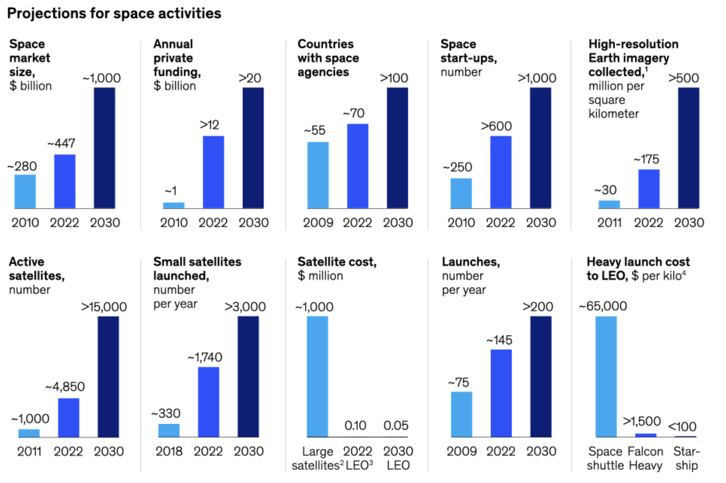
AFFORDABLE HI-TECH CAPABILITIES
Notes:
In 1961, Australia opened its ‘glittering giant’ – a state of the art radio telescope situated in a central west NSW town Parkes. At the time, it was one of the most powerful telescopes in the world. Though the telescope is still operational, Space tech has come a far way from then.
The cost of building, launching and attacking satellites is going down, the potential for benefits is rapidly increasing. All involved parties, including some with ulterior motives, are paying attention.
Since then, the sector has been quietly getting on with things – but as the industry begins expanding at breakneck speed, it’s time for the rest of us to pay attention once more. Australian Space Agency (ASA) plans to grow the national sector to AU$12 billion a year by 2030, accompanied by the establishment of more than 20,000 space industry jobs. The ASA and NASA have announced a mission to send an Australian-made, semi-autonomous rover to the moon, granted in part due to the nation’s mining experience in remote operations and autonomous systems.
Credit: https://www.mckinsey.com/featured-insights/sustainable-inclusive-growth/chart-of-the-day/a-giant-leap-for-the-space-industry

Slide 21
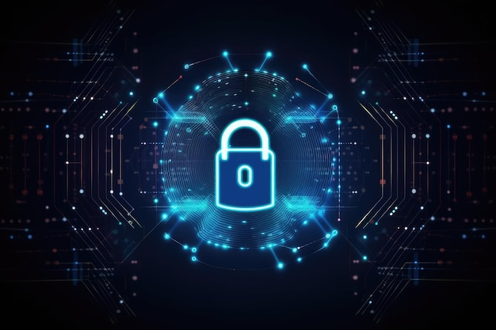
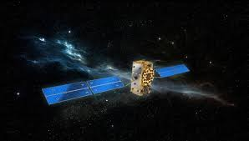
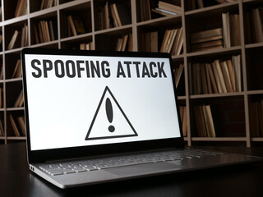
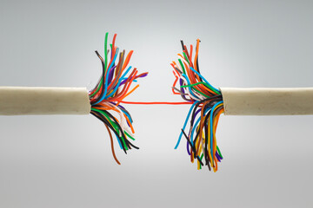
COMPROMISE TYPES
Deny (Jamming, Ransomware)
Degrade (Hijack, Misposition)
Deceive (Spoof, Eavesdrop)
Disrupt (MITM, Others)
Destroy (Grill, Collision)
Notes:
Vulnerabilities that satellites face are conceptually no different from those faced by the traditional critical infrastructure on earth.
https://www.darkreading.com/attacks-breaches/cybersecurity-experts-worry-about-satellite-space-systems
https://resources.infosecinstitute.com/topics/scada-ics-security/hacking-satellite-look-up-to-the-sky

Slide 22
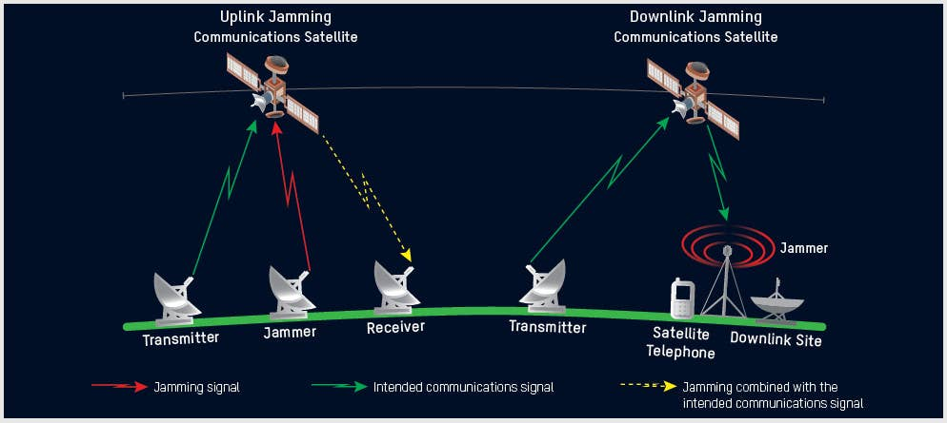
ORBITAL JAMMING
Notes:
The jamming attack could be directed against satellite receiving an uplink or against a ground station or user terminal receiving a downlink. The uplink jamming of the control link can prevent a satellite from receiving commands from the ground. The flooding of an uplink is considered the most damaging attack because it can saturate / destroy all possible recipients.
In Orbital Jamming, the attacker sends a beam of contradictory signals directly toward a satellite or a ground station via a rogue uplink station. The jamming signals are mixed with the legitimate signals, thus interfering with them. The jamming signals can override the legitimate transmission, blocking its transmission to the intended recipient.
The most concerning aspect of jamming attacks is that they can be undertaken using off-the-shelf technology and the detection and attribution of intermittent jamming can be difficult.
https://resources.infosecinstitute.com/topics/scada-ics-security/hacking-satellite-look-up-to-the-sky
https://www.thedrive.com/the-war-zone/43328/u-s-satellites-are-being-attacked-everyday-according-to-space-force-general

Slide 23
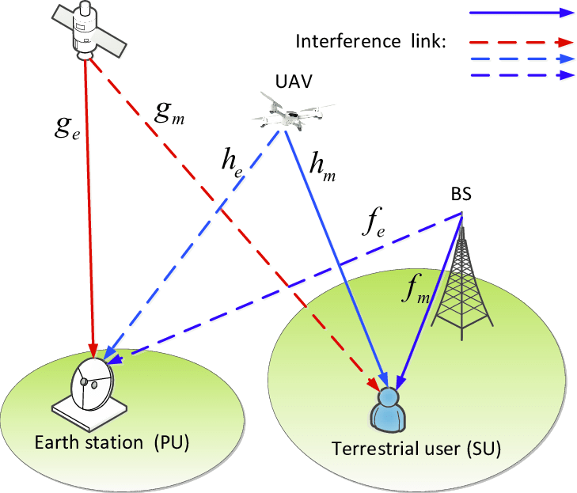
TERRESTRIAL JAMMING
Notes:
In terrestrial jamming, the attacker transmits rogue frequencies in the direction of terrestrial targets (ground satellite dishes). Rather than targeting the satellite itself, as is the case in orbital jamming, terrestrial jamming involves transmitting rogue frequencies in the direction of local consumer-level satellite dishes. The jamming frequencies are limited to a specific area and are able to interfere only with the frequency emanating from the satellite in a specific location. Small, portable terrestrial jammers are easy to purchase and use; they typically have a range of 3-5 kilometres in urban areas, while in rural areas their range can increase to up to 20 kilometres.

Slide 24
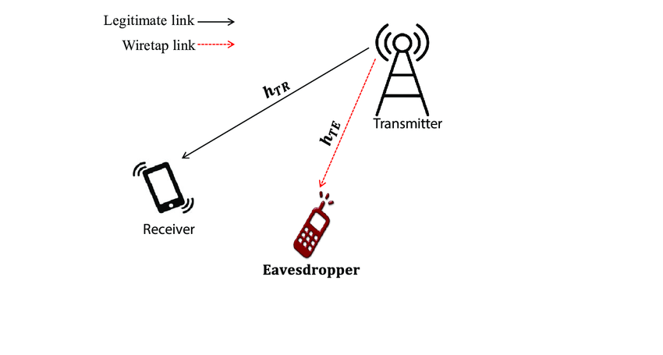
SPOOF / EAVESDROP / MITM
Notes:
One of the temptations of LEO Satellites - which orbit Earth at an altitude of 2,000 kilometres or lower - is the ability of relatively cheap new hardware to do smaller jobs. These Satellites have less resources for computing, processing, and also memory. Less computing power means fewer encryption capabilities, as well as less ability to detect and respond to jamming or other active interference. These Satellites also have frequent handovers that introduce delays and open up more surface for interference. Currently there are no good standards focused on communications for LEO satellites.
https://spectrum.ieee.org/satellite-jamming

Slide 25
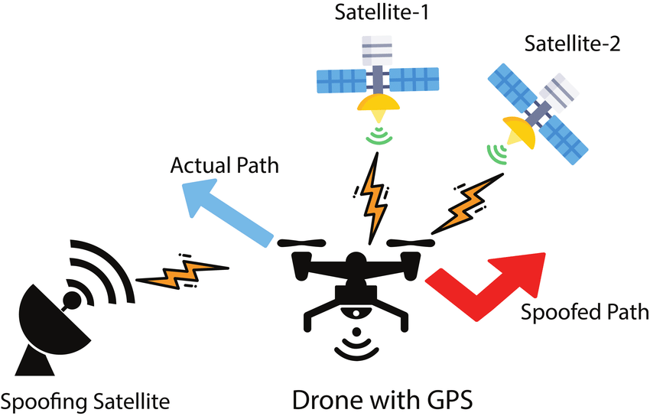
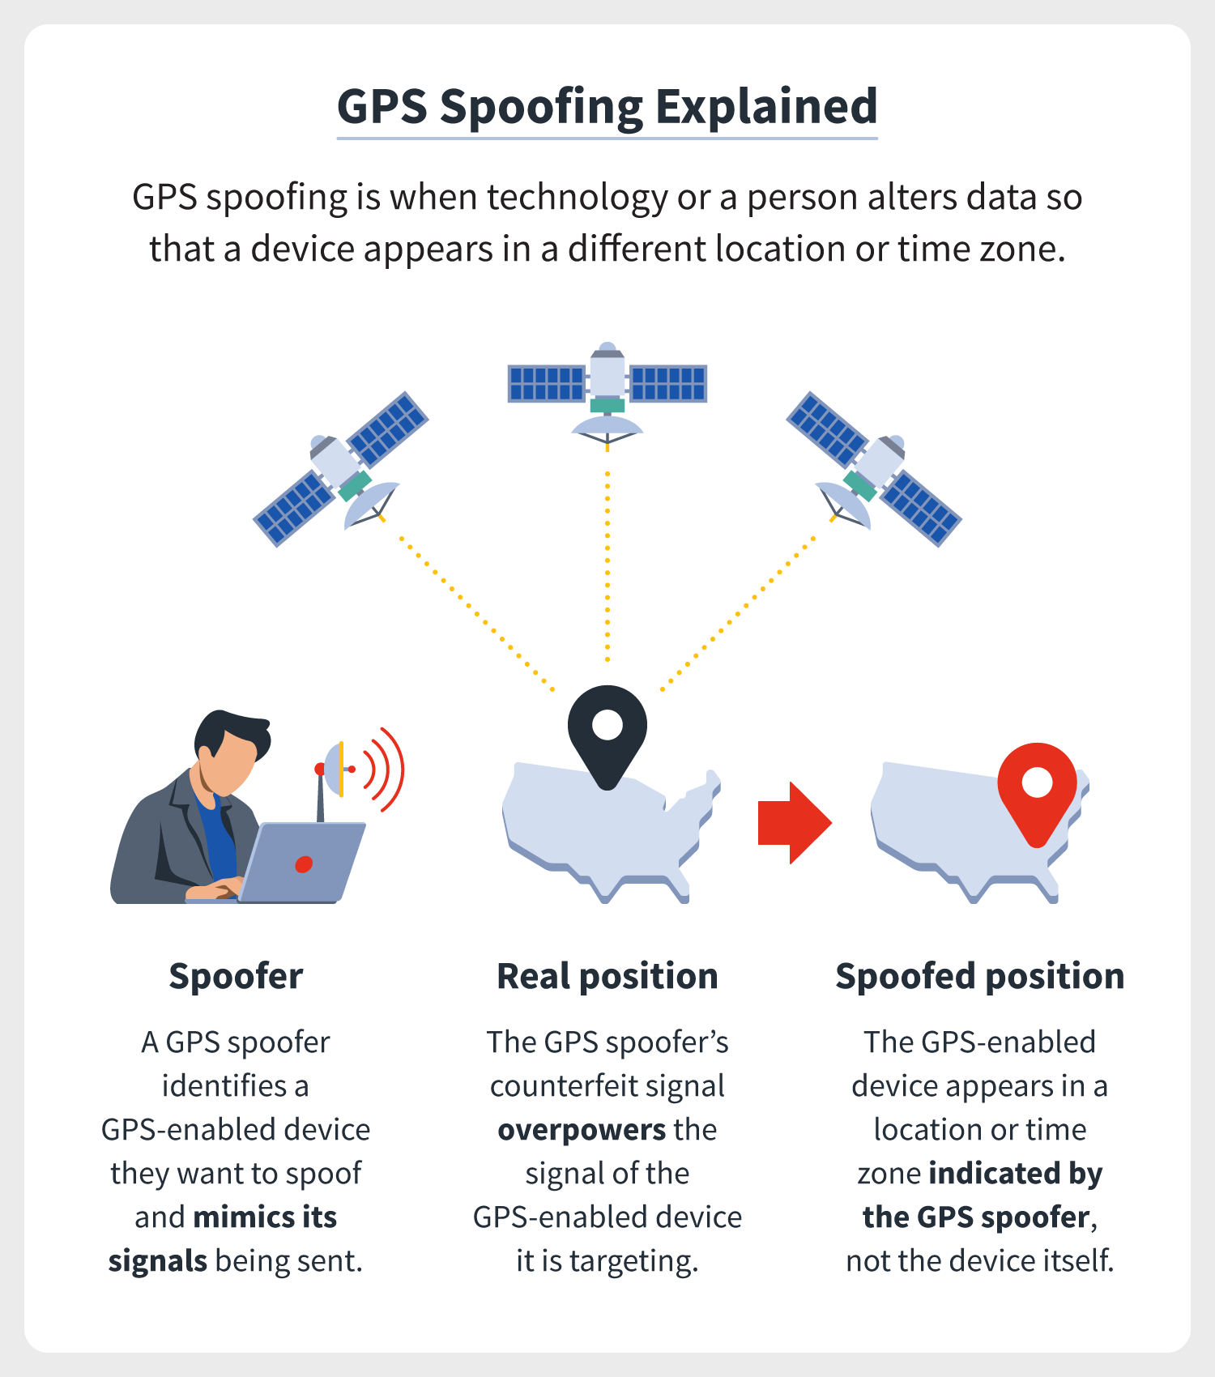
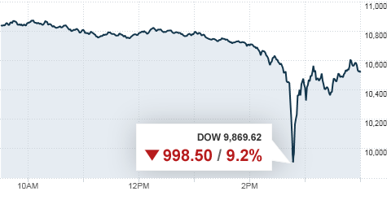
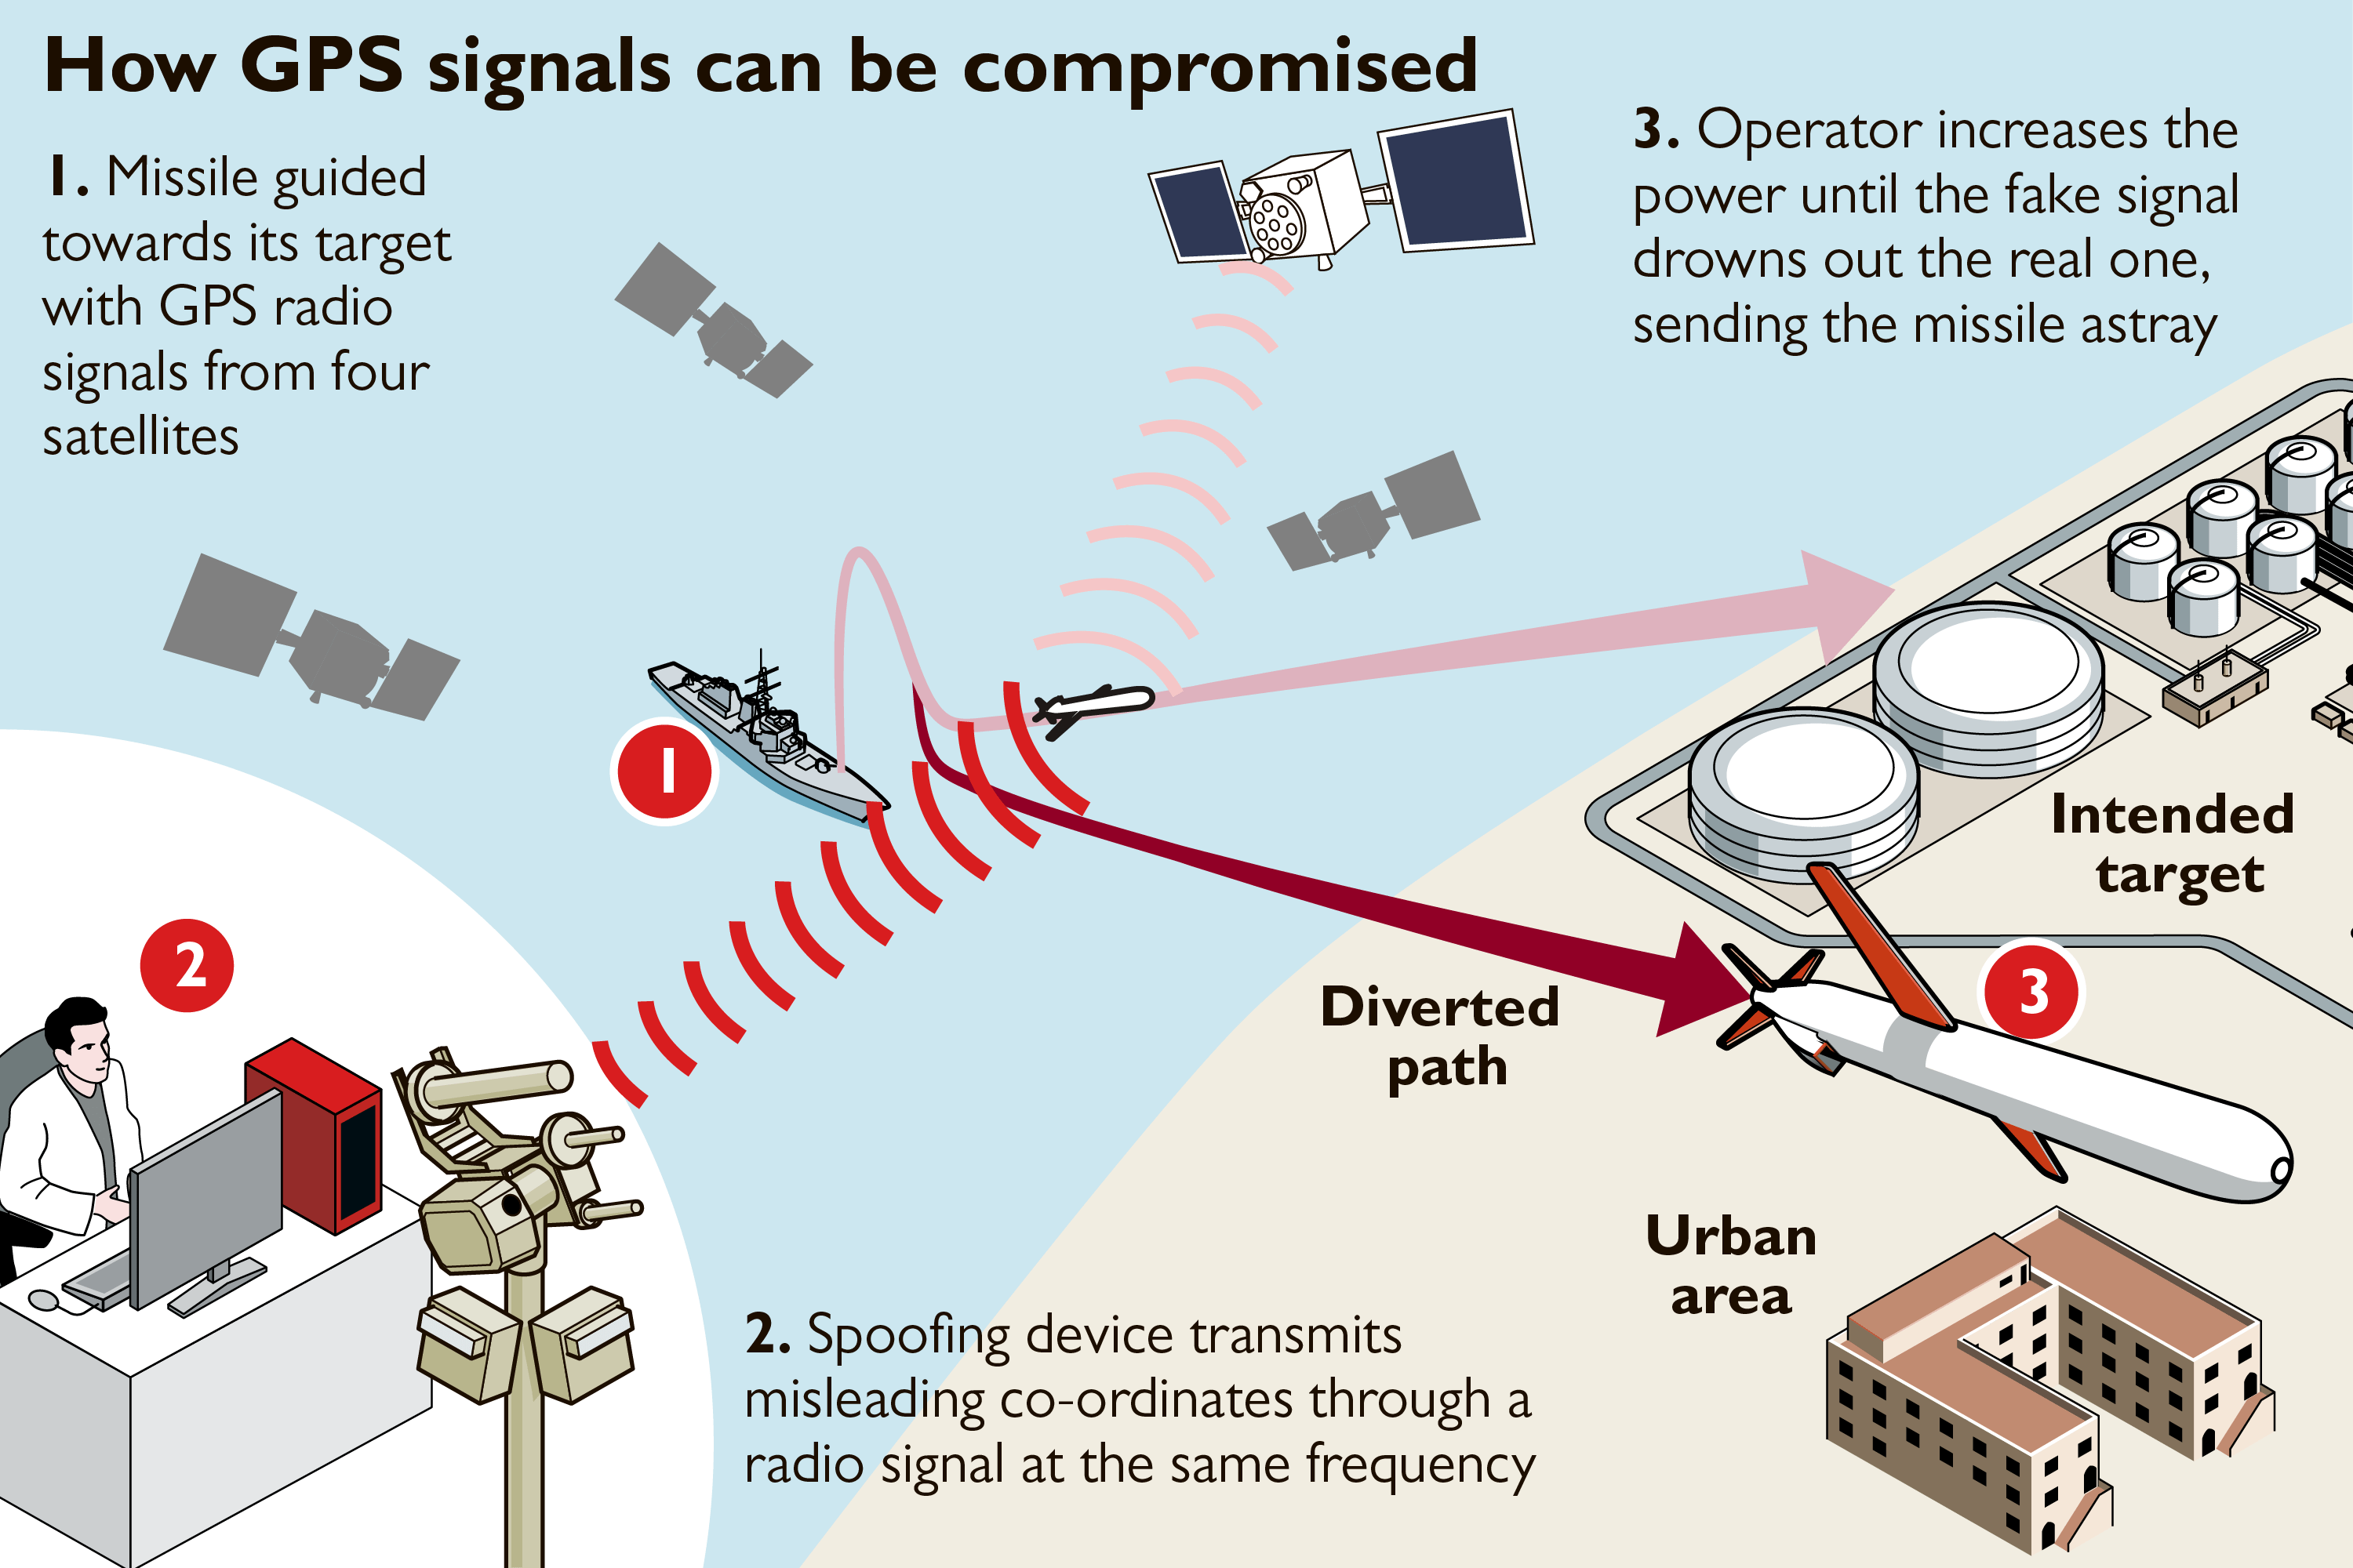
GPS SPOOFING
Notes:
GPS spoofing can have catastrophic consequences, ranging from misdirected flights or drones to missiles. Server times are dependent on GPS, altering server times by even microseconds can significantly impact global economy.
On May 6, 2010, the Dow plummeted inexplicably in a 900-point “flash crash.” Within minutes, the markets had almost completely recovered, but the episode sent chills through the financial world. What had gone wrong? Government and private teams pored over market data in an attempt to identify the trigger. The CFTC and the SEC produced a joint report in September of 2010 that faulted an overly aggressive automatic sell program which sold off $4.1 billion in contracts in just over 20 minutes. The report noted that there were some delays in market data dissemination, but concluded that these delays were more a symptom than a cause of the crash.
https://us.norton.com/blog/emerging-threats/GPS-spoofing
https://radionavlab.ae.utexas.edu/images/stories/files/papers/summary_financial_sector_implications.pdf

Slide 26
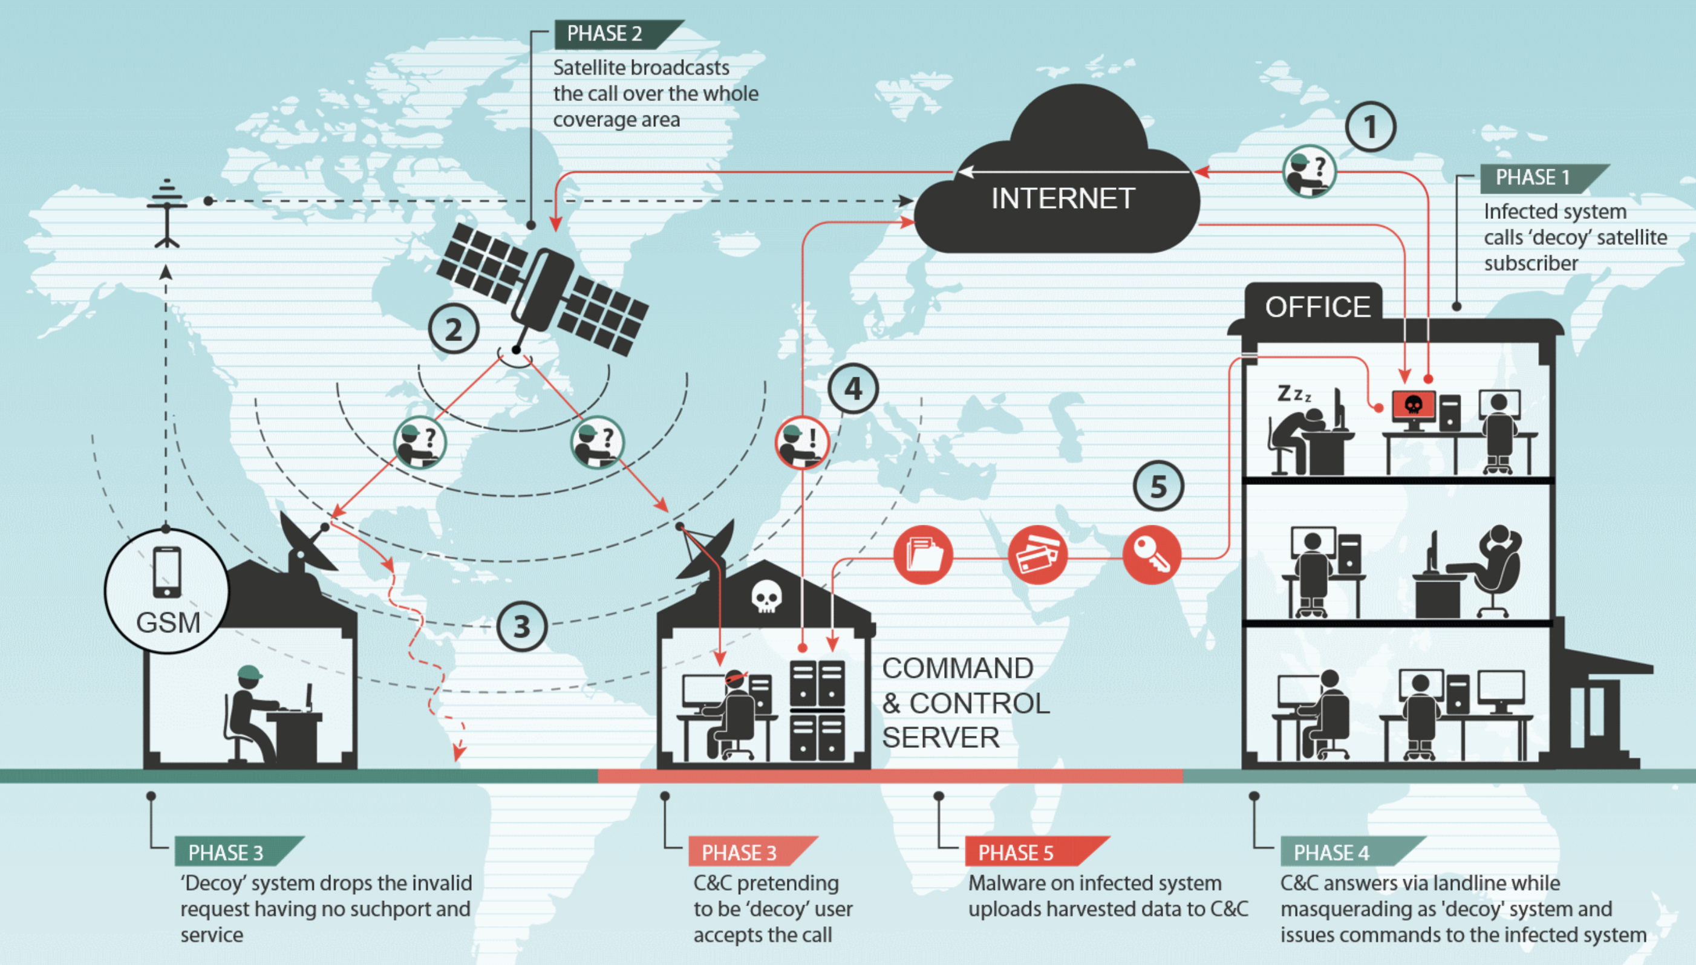
SATELLITE INTERNET HIJACK
Notes:
Many satellite internet providers in the Middle-Eastern and African countries provide downstream-only Internet which allow high speed downloads. These downstream-only Internet links and are very cheap and easy to deploy. They are also inherently insecure and use no encryption to obfuscate the traffic. This creates the possibility for abuse.
Companies that provide downstream-only Internet access use teleport points to beam the traffic up to the satellite. The satellite broadcasts the traffic to large areas on the ground.
The attackers abuse the fact that the packets are unencrypted. Once an IP address that is routed through the satellite’s downstream link is identified, using their own satellite dishes pointed to the specific satellite that is broadcasting the traffic, the attackers start listening for packets coming from the Internet to this specific IP. When such a packet is identified, they identify the source and spoof a reply packet (e.g. SYN ACK) back to the source using a conventional Internet line.
https://securelist.com/satellite-turla-apt-command-and-control-in-the-sky/72081

Slide 27
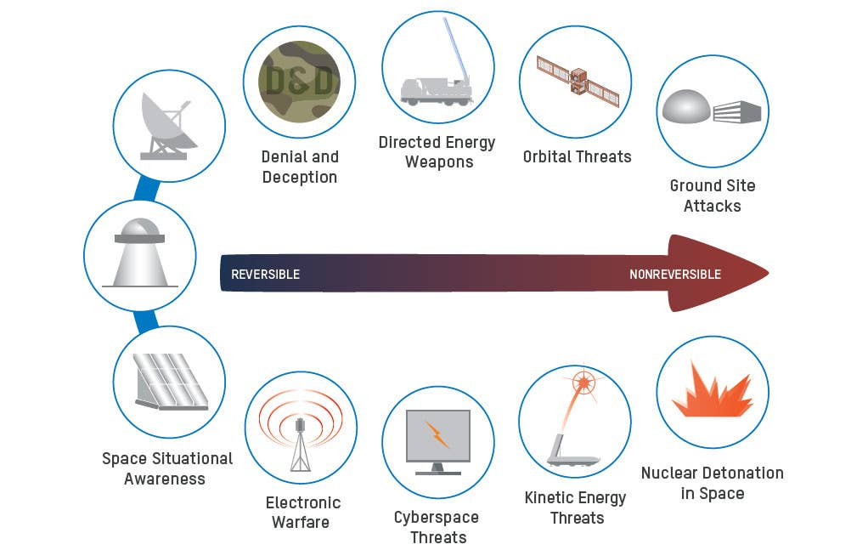
ATTACK SEVERITY
Notes:
U.S. Space Force's General David Thompson, the service's second in command, recently said that Russia and China launch cyber-attacks, on U.S. satellites "every single day.”
Perhaps the most devastating threat could come from a low-yield nuclear device, on the order of 50 kilotons, detonated a few hundred kilometres above the atmosphere. A nuclear detonation would increase ambient radiation to a level sufficient to severely damage nearby satellites and reduce the lifetime of satellites in LEO from years to months or less. The lingering effects of radiation could make satellite operations futile for many months. Even nuclear detonations in the 10-kiloton range could have significant effects on satellites for many months. To execute this mission, all that is needed is a rocket and a simple nuclear device.
https://www.thedrive.com/the-war-zone/43328/u-s-satellites-are-being-attacked-everyday-according-to-space-force-general
https://aerospace.csis.org/wp-content/uploads/2018/09/Space-System-Threats.pdf

Slide 28
CONSEQUENCE MODELLING
T0 | All flights grounded, trains stopped, massive traffic jams (suddenly no GNSS* signals) Delayed intervention police/ambulances/fire brigades (no GNSS) Cash-dispensers stop working (GNSS controlled)
T+ 2hrs | Stock markets drop considerably Congestion terrestrial communications and remote access (oceanic/polar) interrupted
T+ 7hrs | News agencies and energy companies hit
T+ 11hrs | No thunderstorm/hurricane/natural disaster warnings anymore
T+ 1 day | Government limits public access to give priority to crisis communication No public access to social media
T+ 2 days | Financial transactions stop (no timestamp) Breakdowns of power stations (uncontrolled overload)
T+ 3 days | Power blackouts (no power synchronisation) Food and temperature sensitive medicaments affected
T+ 4 days | Food supply chain starts to break down Panic buying of food, plundering
T+ 5 days | Fresh water shortage Travel heavily affected, Societal isolation
T+ 2 weeks | No forecasting of solar activity Disrupted power grids due to solar storms
T+ 1 month | Government will launch emergency satellites using existing military launchers
T+ 2 months | Economy strongly affected Communication companies bankrupt Factories with complex delivery system bankrupt
T+ 3 months | Strategically important satellite constellations launched (military)
T+ 4 months | Strong public push to increase space budgets immediately!
T+ 6 months | New LEO constellations operational
T+ 12 months | New GEO satellites operational
Notes:
This is our future, a highly controlled and unliveable planet ravaged by wars and irreversible global natural disorder – both caused decidedly by humans.
The London School of Economics has developed a realistic model showing consequences of global satellite attacks.
Global navigation satellite system (GNSS) is a general term describing any satellite constellation that provides positioning, navigation, and timing (PNT) services on a global or regional basis.
https://www.lse.ac.uk/ideas/projects/space-policy/publications/Cyberattacks-on-Satellites

Slide 29
RESOURCES
RESOURCES

Slide 30
NIST FRAMEWORKS
NISTIR 8270
(Considerations)
NISTIR 8401
(Applying the CSF)
NISTIR 8323R1
(Foundational Profile)
Notes:
https://www.nist.gov/system/files/documents/2023/07/20/NICE%20July%202023%20Webinar.pdf

Slide 31
NIST NCCOE Cybersecurity Space Domain
NIST Space Cybersecurity Symposium; Free webinars
Notes:
https://www.nccoe.nist.gov/cybersecurity-space-domain
https://www.nist.gov/system/files/documents/2023/07/20/NICE%20July%202023%20Webinar.pdf
NIST also organises annual free space cyber symposiums

Slide 32
Notes:
CYSAT https://cysat.eu April 24 – 25th, 2024; Free Seminar in Paris and online webinars

Slide 33
Notes:
https://hackasat.com/
Hack-A-Sat is a Capture the Flag (CTF) competition designed to inspire the world's top cybersecurity talent to develop the skills necessary to help reduce vulnerabilities and build more secure space systems. The most recent event concluded in August 2023

Slide 34
Notes:
https://spacehack.cbrin.com.au
Our own Canberra Innovation Network has been holding annual events focused on space cyber for many years now. There are many learning and collaboration opportunities across the world and down under.

Slide 35
GLOBAL COLLABORATION

Slide 36
SPACE ISAC
Notes:
The Information Sharing and Analysis Centre in the US has a treasure trove of resource. They are a bit pricey, but the insights and opportunity to collaborate are worth paying for
https://s-isac.org

Slide 37
ESA
Notes:
The European Space Agency regularly holds Open Days. The agency also provides a unique and incredible learning path leading up to jobs at the agency
https://www.esa.int

Slide 38
Wideband Global SATCOM (WGS)
Notes:
Wideband Global SATCOM (WGS) is an international Satellite system, with Australia, Canada, Denmark, Luxembourg, the Netherlands, and New Zealand also investing in the satellite constellation.
The system has been developed to connect military personnel from these countries around the globe, supporting soldiers, ships, and aircrafts.
The project is supposed to create an anchor point for Wideband Global Satellites, essentially a large array of dishes that can bounce signals between ‘birds’ that Australia and its allies use for military communications that underpin everything from guidance systems to surveillance and reconnaissance.
But the project, designated JP2008, has been dragging on, with Northrop Grumman awarded the contract to roll out the new facility back in 2017, a full decade after Australia joined the Wideband Global SATCOM system in 2007, a constellation of satellites for military communications.
https://www.defenseone.com/insights/cards/space-based-c4isr/4/?oref=d1-cards-continue
https://www.themandarin.com.au/220962-new-defence-satellite-station-cops-red-flag-as-project-of-concern

Slide 39
AUSTRALIA’S CHALLENGES
Environmental issues (bushfires)
Logistic delays with the WGS program
Too dependent on US and UK
Starlink, China, and Kessler Syndrome
Tesla’s dependency on China
Notes:
Among the obvious use cases, we are dependent on Satellites to detect and prevent bushfires
The WGS program is so behind the schedule
Kessler Syndrome is a scenario in which the density of objects in low Earth orbit (LEO) due to space pollution is numerous enough that collisions between objects could cause a cascade in which each collision generates space debris that increases the likelihood of further collisions.
China could use Tesla’s plants as carrots or sticks to put pressure on SpaceX to curtail access to Starlink as a geopolitical tool
https://australian-crisis-simulation-summit.com/2021/09/10/why-australia-must-improve-its-cyber-space-defensive-capabilities/
https://www.afr.com/technology/is-elon-musk-a-threat-to-australia-20230823-p5dyui

Slide 40
SOLUTIONS
Australian Space Cyber Framework
Australian Energy Sector Cyber Security Framework (AESCSF)
SOCI Act
Defence Space Command
Space Bridge Framework Arrangement
Australian Space Agency (ASA)
Minister for Cyber Security (Clare O’Neil)
Cyber Security Coordinator (Michelle McGuinness)
Artemis Accords
United Nations Committee on the Peaceful Uses of Outer Space (UNCOPUOS)
Notes:
Need for Thought Leadership (both as an industry and as a nation) – Starlink’s monopoly, other countries’ counter-attack. Kessler Syndrome
https://www.cyberops.com.au/space-cyber-framework
https://www.lexology.com/library/detail.aspx?g=63aef398-2c65-4f01-bb5e-6a1ae5f69728

Slide 41
CONCLUSION
Space and cyber warfare are teaming up to become the ultimate battleground of the 21st century. It's like a tag team match where space and cyber are the heavy hitters.
Cyberattacks on Satellites are no longer just a sci-fi plot. They're happening in real life, and they're not just the work of nations but also rogue players like shady criminal gangs and even terrorists.
This space-cyber combo isn't just a threat to big institutions and governments. It's a risk to our everyday security, the stuff that keeps our economies humming, and the companies we rely on.
Our rulebooks and policies, both local and international, aren't prepared for this new space-cyber tag team. We urgently need to step up our game, create strong national policies, upskill our experts, and build a flexible international plan to tackle this ever-growing cyber, economic, and existential threat.
Notes:
https://www.sciencedirect.com/science/article/pii/S138912862200319X#b9

Slide 42
THANK YOU
Gaurav Vikash
gaurav@cybernion.com
0404 760 923

