Slide 1
Which and How of Cybersecurity Frameworks
Identify and Implement The Perfect Fit
Gaurav Vikash

Slide 2

TOO MANY FRAMEWORKS
IRAP
Essential 8
DISP
RFFR
ISO 27001
ISO 27701
ISO 27017, 27018
ISO 9001
NIST AI RMF
SOC 2
ISO 42001
ISO 23053

Slide 3





WHY? / ADVANTAGES OF THE RIGHT FRAMEWORKS
Global Compliance
Secure
Workforce
Global Partnerships
Customer
Loyalty
Endless Opportunities
Notes:
No business exists just to be secure, businesses exist to serve their customers and stakeholders, and to make money. Information security is an ally that can help the pursuit of these objectives.
Just like having the right enterprise level strategy is crucial to an organisation’s success, carefully choosing and implementing the right security framework can help an organisation comply with the expectations of the industry they operate in, the expectations of their B2B or B2C customers, all while employing secure systems and workforce.
Achieving such high standards can enable truly global partnerships, long-lasting customer loyalty, and ongoing opportunities.

Slide 4
WHY? / ADVANTAGES OF THE RIGHT FRAMEWORKS
COMPLIANT | CERTIFIED | SECURE
✔ | ✘ | ✘
✘ | ✔ | ✘
✔ | ✔ | ✘
✘ | ✘ | ✔
✔ | ✔ | ✔
Compliant and Certified, but not Secure
Secure without Compliance or Certification
Compliant Certified, Secure
Notes:
2 important acknowledgements
Implementing some security frameworks without proper contextualisation may not lead to truly effective security
On the other end of the spectrum, truly effective security can be achieved without implementing frameworks
An organisation needs to be clear about its objectives before commencing its compliance journey, or not.
The right frameworks don’t just help tick the compliance box, they tangibly uplift the organisational security posture.
An inherently secure organisation, compliant and certified with globally respected security frameworks will be able to confidently pursue business opportunities anywhere in the world.

Slide 5

WHICH?
Figuring Out The Right Framework(s)
Notes:
So, how exactly do we figure out the security frameworks most relevant to our unique organisation?

Slide 6
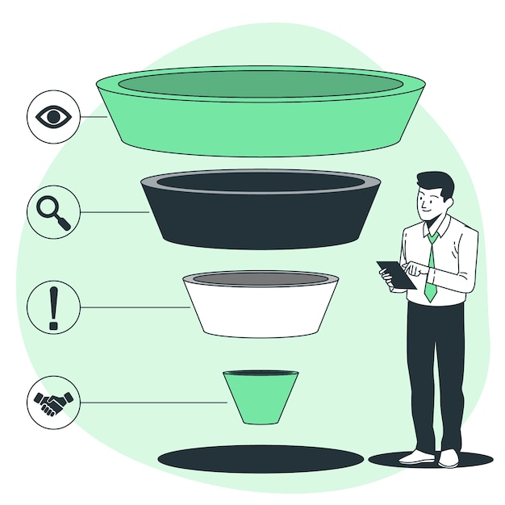
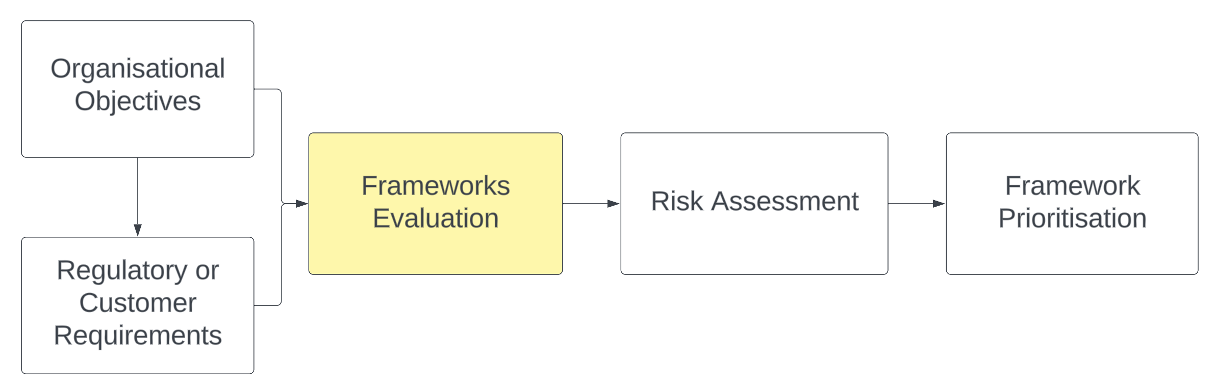
FIGURE OUT THE RIGHT FRAMEWORK(S)
Notes:
Organisational Objectives: Start by clearly understanding your organisation’s business/enterprise objectives. These organisation level objectives should inform the Security objectives, and then in turn, achieving the security objectives should enable the organisational objectives. Implementing certain frameworks such as ISO 27001, IRAP, etc. can unlock business opportunities.
Regulatory or Customer Requirements: Identify the legal and regulatory requirements that apply to your organisation based on your industry, operating locations, and the information you handle. Determine if there are specific frameworks mandated by these regulations. For example, PCI DSS is mandatory if you store or process credit card information, Essential 8 is mandatory if you are a Non-Corporate Commonwealth Entity.
Framework Evaluation: These requirements should help you narrow down to a few frameworks. Analyse them and ensure your list is very specific. Some common ones include ISO 27001, NIST Cybersecurity Framework, CIS Critical Security Controls, and more.
Risk Assessment: With limited budget and time, you can only implement a few of these frameworks. Compare the requirements of various frameworks with your organisation's objectives, risks, and compliance needs. Identify, implementation costs, time commitment, impact on current practices, and ongoing maintenance effort for each framework
Framework Prioritisation: Finally, rank the frameworks based on their alignment with your organisation's needs. Consider both short-term and long-term goals in your assessment.
Now you know where to start and are confident about your why.

Slide 7
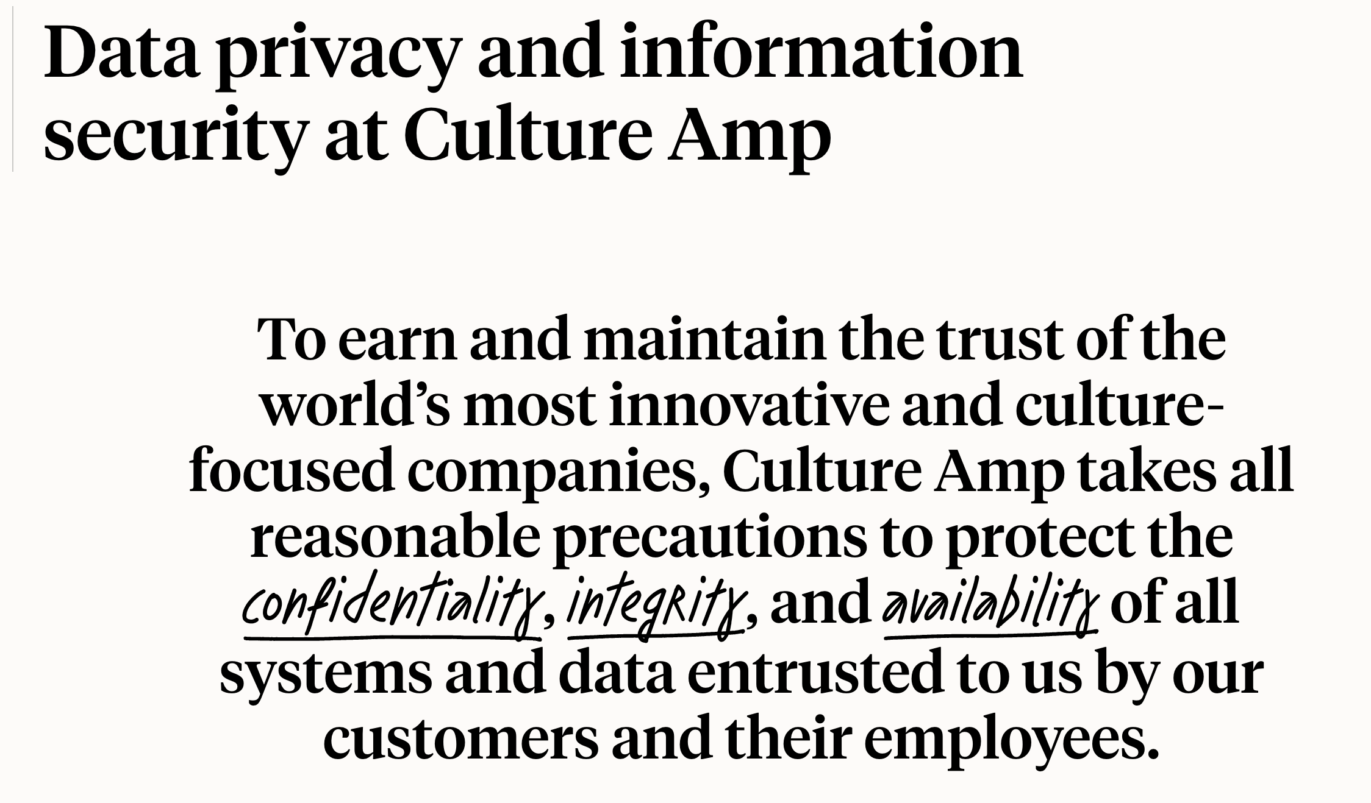
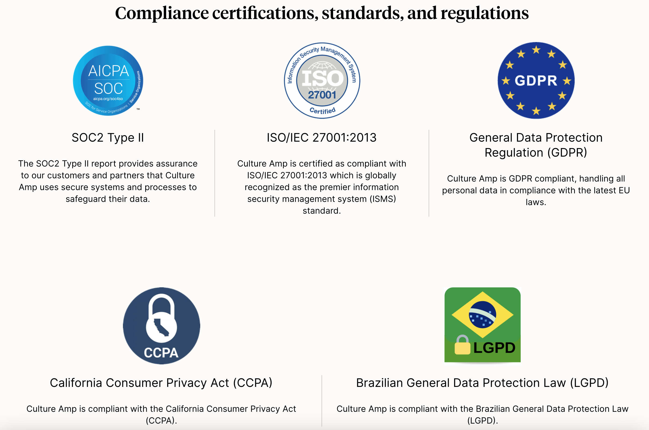
CASE STUDY – CULTURE AMP
Notes:
Let's explore a couple of examples.
Notice that Culture Amp highlights its business goals first, and then shows how its security program enables the business to achieve its goals. Culture Amp’s business presence in the US, UK and Australia informs their compliance program.
https://www.cultureamp.com/data-privacy

Slide 8
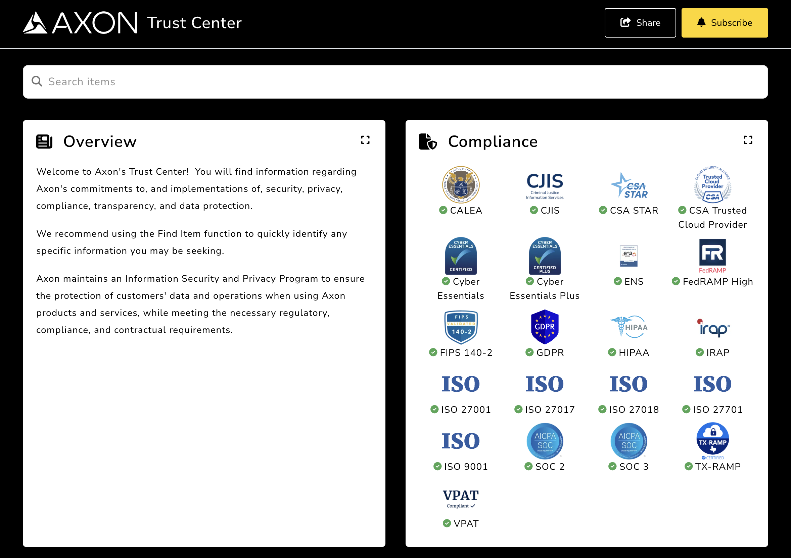
CASE STUDY – AXON
Notes:
Notice how Axon highlights the relation between its security program and customer expectations.
Axon’s truly global operations require them to implement and maintain a diverse set of security frameworks.
The clear understanding of global business drivers and customer expectations ensures that they prioritise what their customers expect.
https://trust.axon.com/

Slide 9
FRAMEWORK OVERVIEW
Notes:
This presentation focuses on framework evaluation to help organisations make informed decisions.

Slide 10
FRAMEWORK EVALUATION
Framework | Description | Mandatory | Industry Expectation (Ticket to Play)
IRAP | Information Security Registered Assessors Program, following the Information Security Manual (ISM) | Federal agencies and Organisations providing products or services to Federal agencies | No other organisation
SOC2 Type 2 | Service Organisation Control, following the AICPA Trust Services Criteria | No organisation | Financial Institutions SaaS product providers Organisations storing customer data in cloud
Essential Eight | Strategies developed by ASD to protect Microsoft Windows-based internet-connected networks | Non-corporate Commonwealth entities (NCCEs) | Most organisations
ISO 27001 | Focused on the ISMS following ISO 27002 controls | No organisation | Most organisations
Notes:
AICPA: American Institute of Certified Public Accountants
ASD: Australian Signals Directorate
ISM: Information Security Manual
ISMS: Information Security Management System

Slide 11
FRAMEWORK EVALUATION
Framework | Description | Mandatory | Industry Expectation (Ticket to Play)
ISO 27701 | Privacy Information Management System (PIMS) framework, the data privacy extension of ISO 27001 | No organisation | Cloud Service Providers, Cloud Service Consumers
ISO 27017, ISO 27018 | Focused on the security of PII in Cloud, following ISO 27002 controls | No organisation | Cloud Service Providers
ISO 9001 | Focused on Quality Management, following 7 quality management principles | No organisation | Most organisations
ISO 42001 (emerging) | Requirements for establishing, implementing, maintaining, and continually improving an Artificial Intelligence Management System (AIMS) | No organisation (yet) | Most organisations

Slide 12
FRAMEWORK EVALUATION
Framework | Description | Mandatory | Industry Expectation (Ticket to Play)
ISO 23053 (emerging) | Establishes an Artificial Intelligence (AI) and Machine Learning (ML) framework for describing a generic AI system using ML technology | No organisation (yet) | Most organisations
RFFR | Right Fit For Risk, following ISO 27001, ISM and Essential Eight ML1 controls | Organisations working with the Department of Employment and Workplace Relations (DEWR) | No other organisation
DISP | Defence Industry Security Program, focused on conducting a security vetting of Australian businesses | Organisations wanting to supply products or services to Australian Defence Forces | No other organisation
Notes:
You’d notice a trend emerging.
Most of these security frameworks are not mandated by customers or the industry.
However, all other things being almost equal, customers will choose to work with more secure organisations, customers trust more secure organisations, and customers promote more secure organisations.
These promoters are who make or break companies in industries not dominated by monopolies.
If you want to play in such industries, you'd better pay attention to what your customers expect and admire.

Slide 13
FRAMEWORK EVALUATION
Notes:
Now let’s dive a bit deeper and evaluate some of these frameworks

Slide 14

IRAP
Information Security Registered Assessors Program
Notes:
https://www.cyber.gov.au/irap

Slide 15
IRAP - FRAMEWORK OVERVIEW
ASD’S ROLE
ISM
EFFECTIVENESS
ASSESSMENT
SYSTEMS
CLASSIFICATION
Notes:
Information Security Manual: Based on the Australian Government Information Security Manual (ISM) requirements which update every 3 months to keep up with the evolving threats and technological advances
Information Classification: Limited to assessing the effectiveness of security controls deployed to “information systems” storing or processing classified information
ASD and Industry Assessors: Only ASD is authorised to conduct IRAP assessment of TOP SECRET systems. Other IRAP assessors can assess information systems classified as SECRET and below
Assessment of Effectiveness: IRAP is designed to assess the ”effectiveness”, not just presence of security controls in line with the ISM requirements
No certification or endorsement: Assessors do not accredit, certify, endorse or register systems on behalf of the ASD, they only "assess" the "effectiveness" of security controls, and produce reports
Systems, not Organisations: An organisation cannot claim to be IRAP assessed, they can only claim that their “information system” has gone through an IRAP assessment

Slide 16
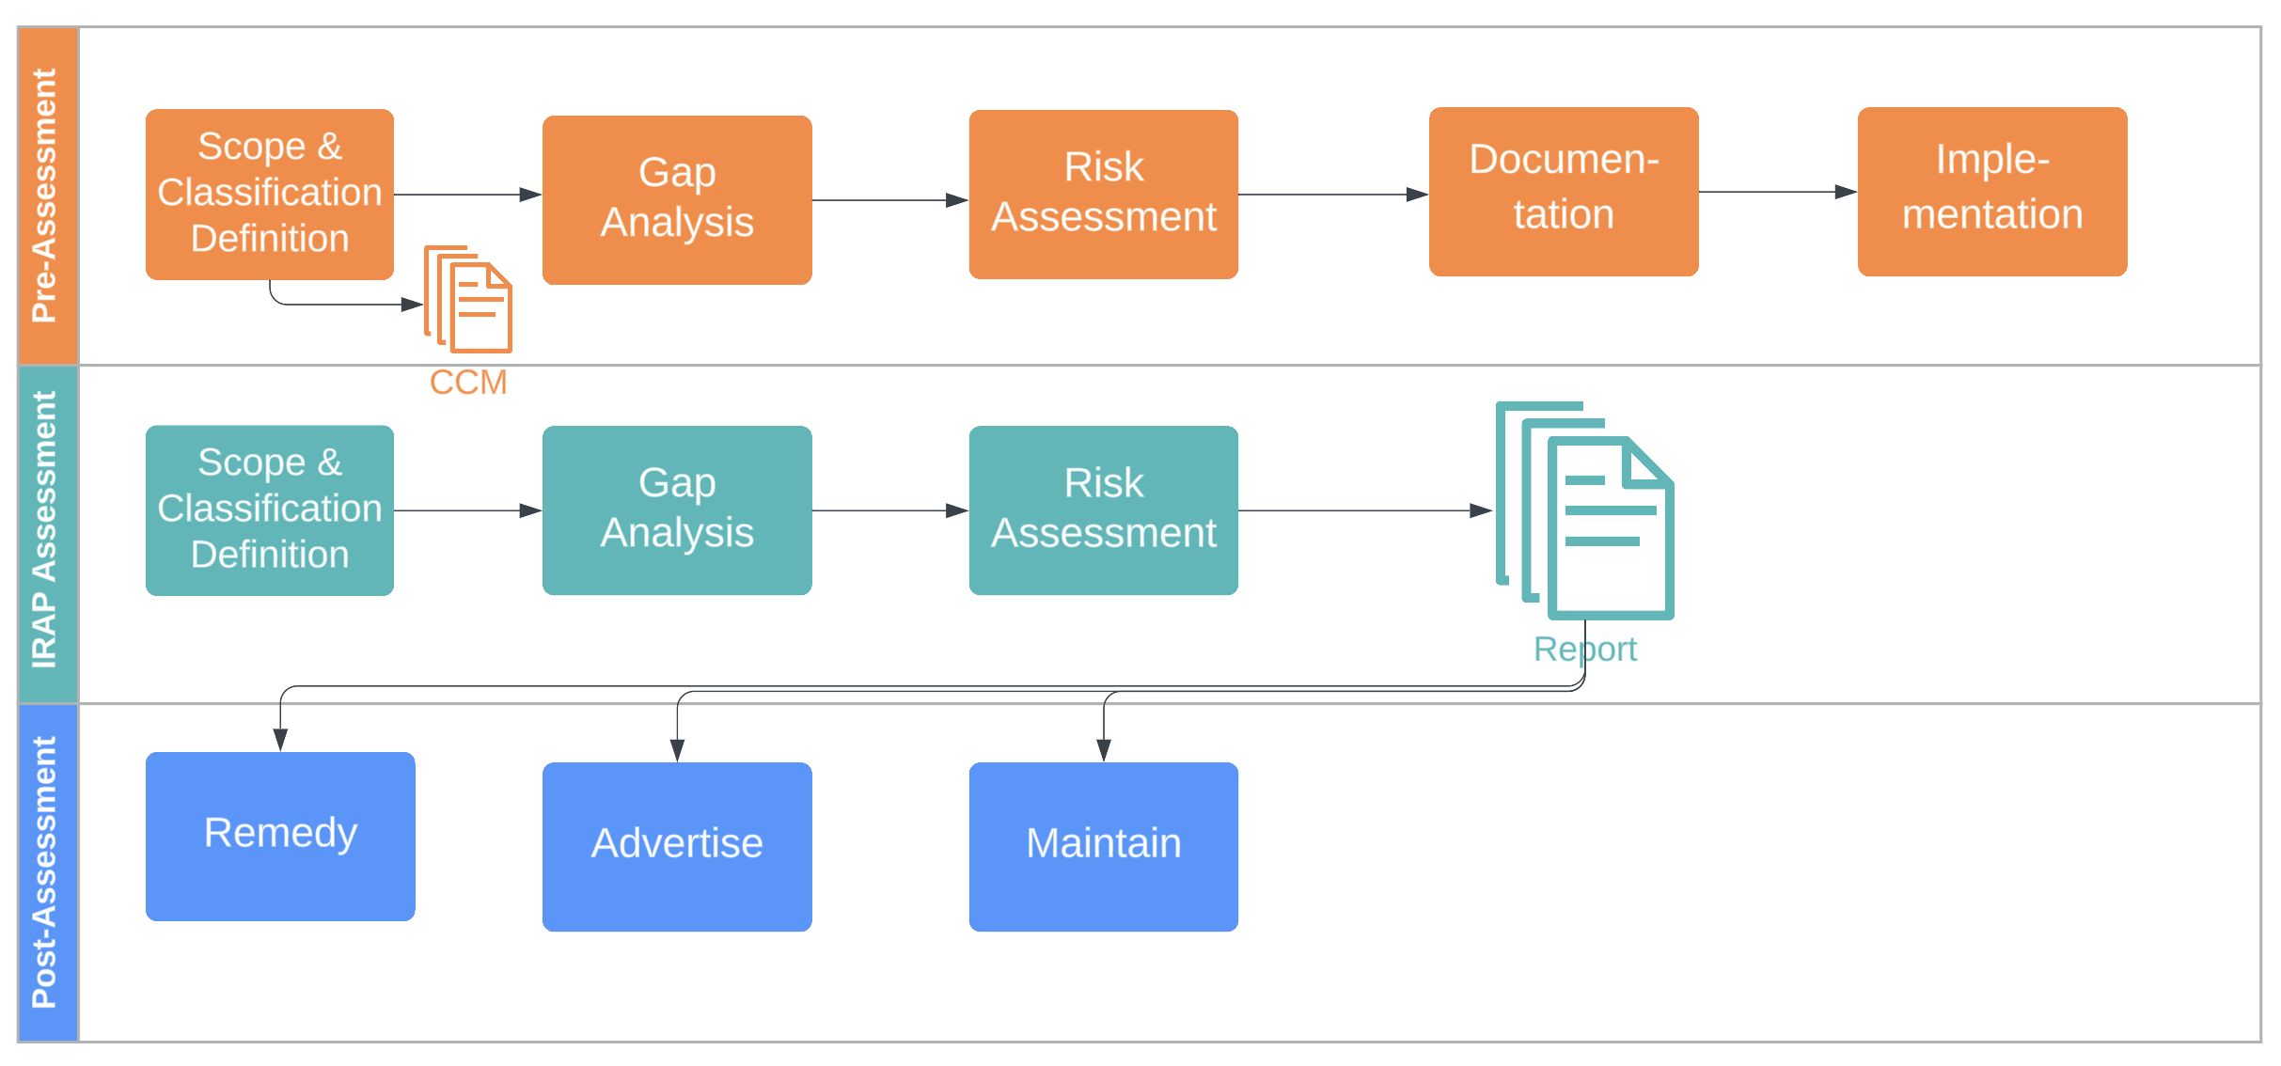
3 PHASES OF THE IRAP PROGRAM
Notes:
Pre-Assessment: Either do it yourself or engage an expert consultancy. Define the scope of the system, understand the information classification, conduct a gap analysis with reference to the ISM controls, address those gaps based on risk prioritisation
Assessment: Avoid conflicts of interest
Post-assessment: Maintain and plan an assessment every 1 or 2 year, depending upon contractual obligations
CCM: Cloud Controls Matrix

Slide 17
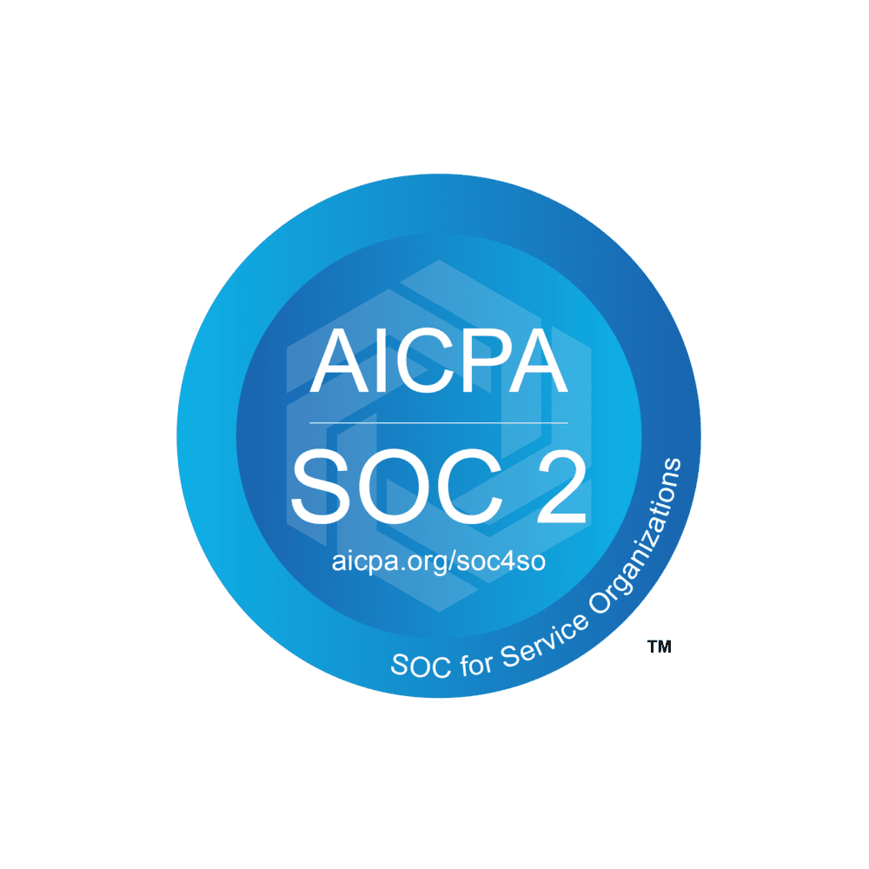
SOC 2 Type 2
Service Organisation Control Type 2
Notes:
Formerly SAS70 Report. Developed by the American Institute of Certified Public Accountants (AICPA) in 2010
SOC 2 Type I reports evaluate a company’s controls at a single point in time. It answers the question: are the security controls designed properly?
SOC 2 Type II reports assess how those controls function over a period of time, generally over 12 months. It answers the question: do the security controls a company has in place function as intended

Slide 18
SOC 2 - FRAMEWORK OVERVIEW
Security*
Availability
Processing Integrity
Confidentiality
Privacy
The five categories of Trust Services Criteria (TSC) help
Organisations effectively secure customers’ data in the cloud
Auditors assess the operating effectiveness of the organisation’s security controls
Notes:
The Security TSC is always included in a SOC 2 audit, while the other four are optional
Security is also referred to as the Common Criteria, since many of the security criteria are shared among all the Trust Services Criteria

Slide 19
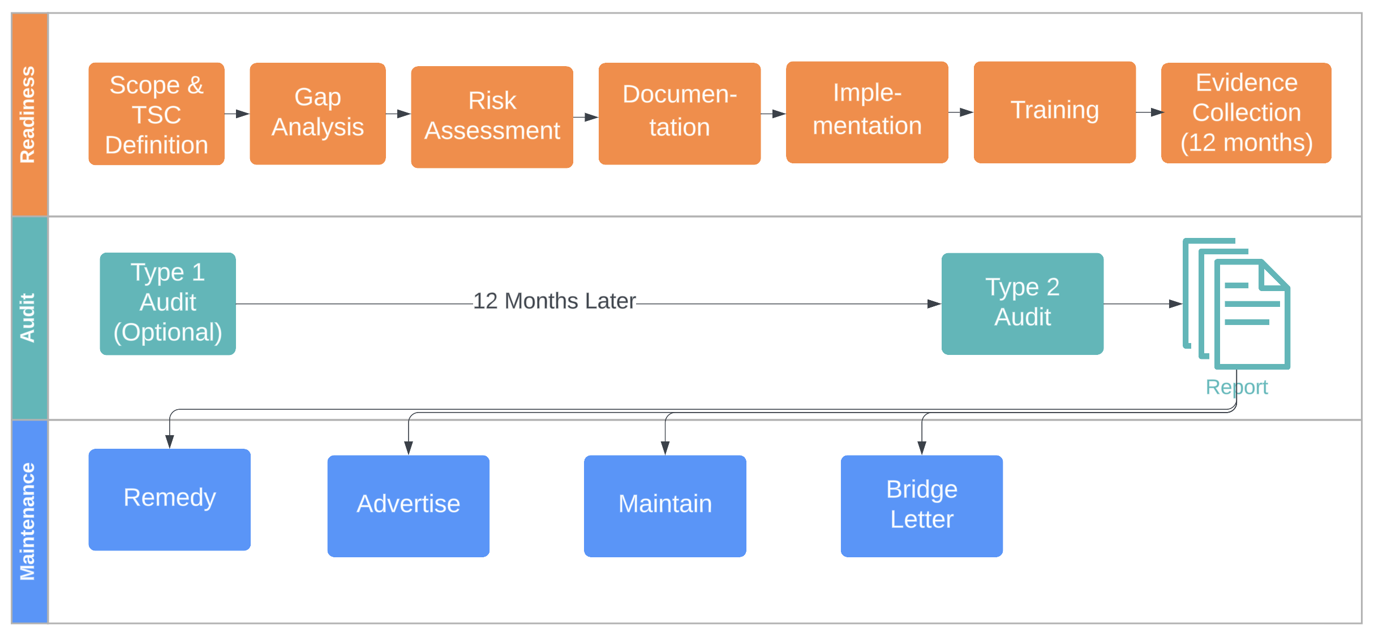
SOC 2 - PROGRAM OVERVIEW
Notes:
While some security frameworks such as ISO 27001 and PCI DSS have rigid requirements, that isn’t the case with SOC 2.
Controls and attestation reports are unique to every organisation. Each organisation designs its own controls to comply with its chosen Trust Services Criteria.
An independent auditor is then brought in to verify whether the company’s controls satisfy SOC 2 requirements.
After the audit, the auditor writes a report about how well the company’s systems and processes comply with SOC 2. There is no certification, there is no pass or failure
Requires annual audits and reports
Bridge Letter
A bridge letter (also known as a gap letter) bridges the gap between the end of your last SOC 2 report audit period and the current date.
Say your organisation completed a SOC 2 report that covers September 30, 2022 - October 1, 2023. But your organisation’s fiscal year-end is December 31, 2023.
You can provide customers with a bridge letter that states there have been no significant changes to your controls between October 1 and December 31. Or if there have been material changes, explain what they are and assure customers that they wouldn't affect the results of your SOC 2 report.
Bridge letters typically don’t cover a period of more than three months. A bridge letter isn’t a replacement for an up-to-date SOC 2 report, but it can be a helpful tool to provide assurance to clients between audits.
Bridge letters are issued and signed by the organisation’s management and sent directly to customers. The CPA firm that conducted the SOC audit is not involved as the auditor can no longer attest that the customer’s environment operates in the same fashion.

Slide 20
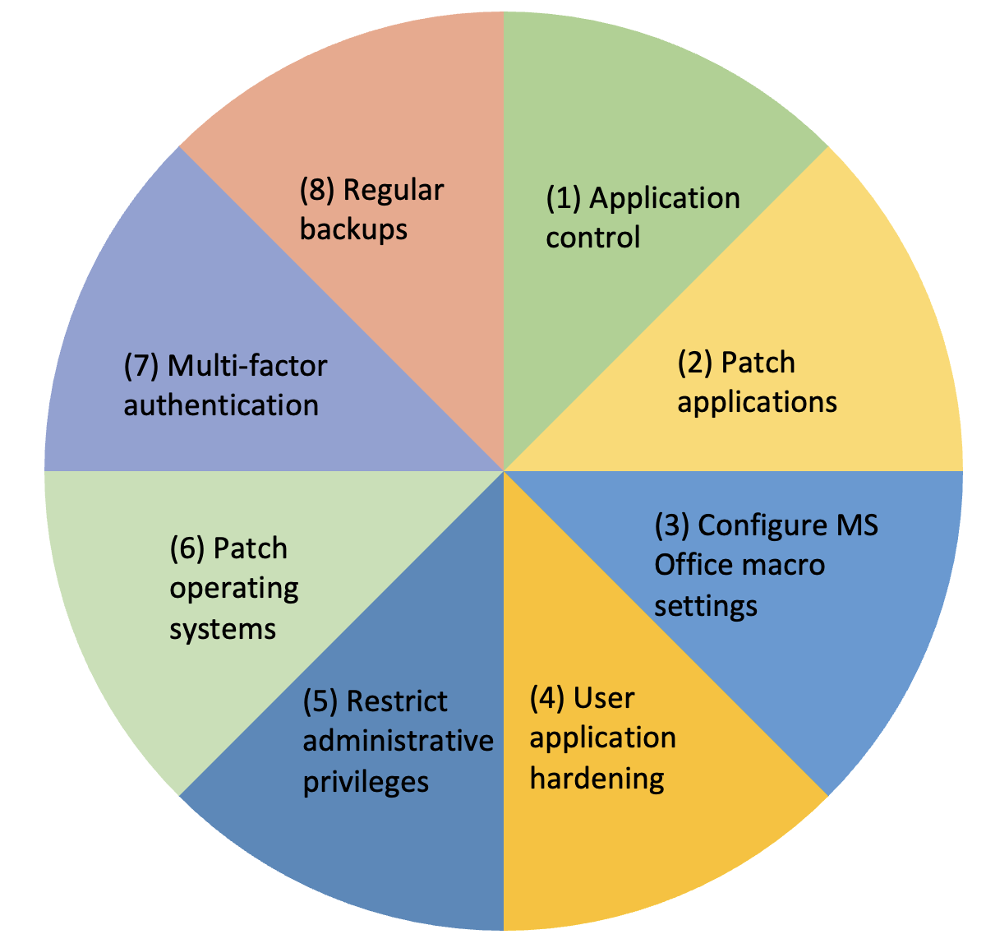
ESSENTIAL EIGHT
Notes:
https://www.cyber.gov.au/resources-business-and-government/essential-cyber-security/essential-eight/essential-eight-maturity-model

Slide 21
ESSENTIAL EIGHT – FRAMEWORK OVERVIEW
A set of eight mitigation strategies
Minimum baseline for cyber threat protection. Most organisations would need additional security controls
Three* target maturity levels (Maturity Level One through to Maturity Level Three), based on mitigating increasing levels of adversary targeting and tradecraft
A self-assessment framework, independent audit or certification not mandatory yet for most organisations
Mandatory for the non-corporate Commonwealth entities (NCCEs) to go through a comprehensive audit every 5 years
Updated November 2023
Assessment Course https://www.tafecyber.com.au
ML1
ML2
ML3
Notes:
Assessment Course: Designed by ASD, delivered by TAFE. The Essential Eight Assessment Course is a face-to-face three-day course that uses a blend of specialist expertise, knowledge and hands-on technical training. It will teach participants how to conduct accurate and consistent Essential Eight assessments, and practically apply the Essential Eight Assessment Process Guide.
Application control
Patch applications
Configure Microsoft Office macro settings
User application hardening
Restrict administrative privileges
Patch operating systems
Multi-factor authentication (MFA)
Regular backups
Maturity Level 1: Partly aligned with mitigation strategy objectives
Maturity Level 2: Mostly aligned with mitigation strategy objectives
Maturity Level 3: Fully aligned with mitigation strategy objectives

Slide 22
ESSENTIAL EIGHT - PROGRAM OVERVIEW
Determine Maturity Level
Implement Wholesomely
Risk-Based Approach
Self-Assessment
Maintenance
Notes:
1 – 3 months for a small to medium business
3 – 6 months for a large business
Determine Maturity Level: Identify and plan for a target maturity level suitable for your environment
Wholesome Implementation: Target the same maturity level across all eight complementary mitigation strategies
Risk-based Approach: Deploy risk-commensurate controls and minimise exceptions
Customisation is key for every level, ensuring alignment with each business's distinct risk profile. This approach empowers organisations to pinpoint their existing compliance status and comprehend the exact steps needed to advance through each level.

Slide 23
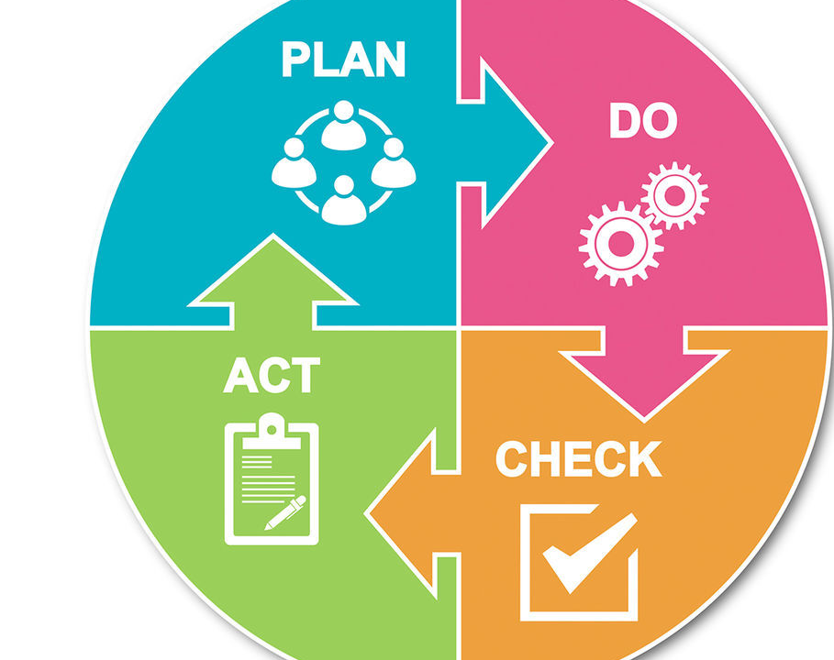
ISO 27001 - ISMS
Notes:
https://advisera.com/iso-27001/

Slide 24
ISO 27001:2022 – FRAMEWORK OVERVIEW
Not a compliance standard. The requirements are not all mandatory. Define your own SoA.
Self selected relevant requirements and organisational policies form the reference for ISMS maturity uplift and the audits.
Starting April 2024, organisations pursuing ISO 27001 for the first time must be certified with the 2022 version.
Organisations who are already certified must transition to this latest version by 31st October 2025.
7 Clauses (30 Requirements)
Context
Leadership
Planning
Support
Operation
Performance Evaluation
Improvement
4 Annexes (93 Requirements)
Organisational Controls
People Controls
Physical Controls
Technological Controls

Slide 25
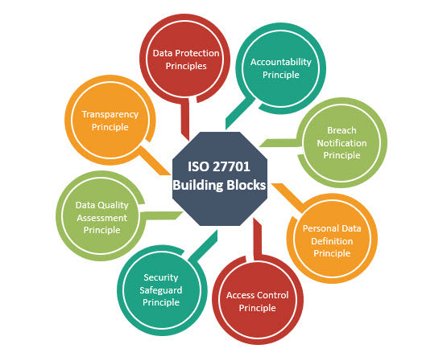
ISO 27701 - PIMS
Notes:
https://advisera.com/27001academy/blog/2019/12/10/relationship-between-iso-27701-iso-27001-and-iso-27002/

Slide 26
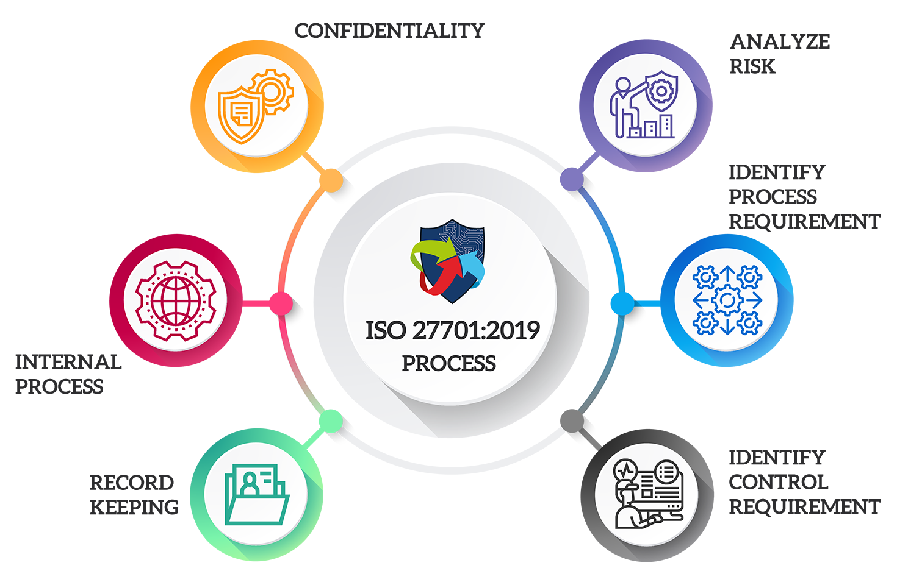
ISO 27701:2019 – FRAMEWORK OVERVIEW
An extension of ISO 27001
Adds a data privacy layer
Specifies the requirements and provides guidance for establishing (plan), implementing (do), maintaining (check) and continually improving (act) a Privacy Information Management System (PIMS)
Extends security efforts to cover privacy management if ISO 27001 is already implemented
Certification is only available as an add-on to ISO 27001 certification and cannot be obtained as a standalone certificate
Notes:
PII: Personally Identifiable Information
If you are ticking the boxes for other standards you may be ticking some of the boxes for ISO 27701 already.

Slide 27
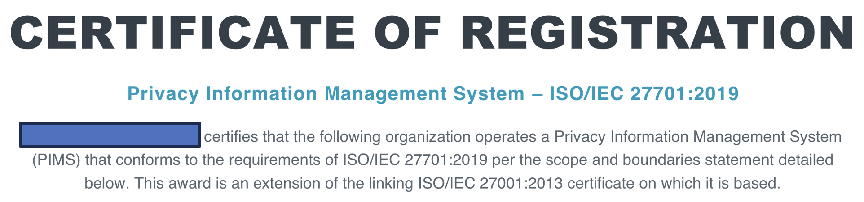
ISO 27701:2019 – EXAMPLE CERTIFICATE

Slide 28
ISO 27017 – Cloud Security
ISO 27018 – PII Security in Public Clouds
Notes:
Cloud service providers can adopt ISO 27001 in combination with ISO 27017, while cloud companies with a high volume of personal data will almost certainly implement all three: ISO 27001, ISO 27017, and ISO 27018.
https://advisera.com/27001academy/blog/2016/08/23/resolving-cloud-security-concerns-by-defining-clear-responsibilities-according-to-iso-27017/
https://advisera.com/27001academy/blog/2015/11/16/iso-27001-vs-iso-27018-standard-for-protecting-privacy-in-the-cloud/

Slide 29
Cloud Service Consumer
Cloud Service Provider
Cloud Service Provider
FRAMEWORK OVERVIEW
ISO 27017:2015
An extension of ISO 27001
Adds a Cloud security layer
Implementation demonstrates that cloud service providers or cloud service consumers have put in place best practices to protect against cloud-related threats
Extends security efforts to cover Cloud security if ISO 27001 is already implemented
Not a management standard, there is no certification. ISO 27001 certification can include a statement of compliance
ISO 27018:2019
An extension of ISO 27001
Adds a security layer focused on protection of PII in Cloud
Implementation demonstrates that cloud service providers have put in place best practices to protect PII against cloud-related threats
Extends security efforts to cover PII security in Cloud if ISO 27001 is already implemented
Not a management standard, there is no certification. ISO 27001 certification can include a statement of compliance
Notes:
ISO 27017 expands the controls of ISO 27001 to cloud security and covers all businesses that operate and use cloud services
ISO 27018, on the other hand, is a standard that is limited to personal information among cloud services and only applies to businesses that provide cloud services.

Slide 30
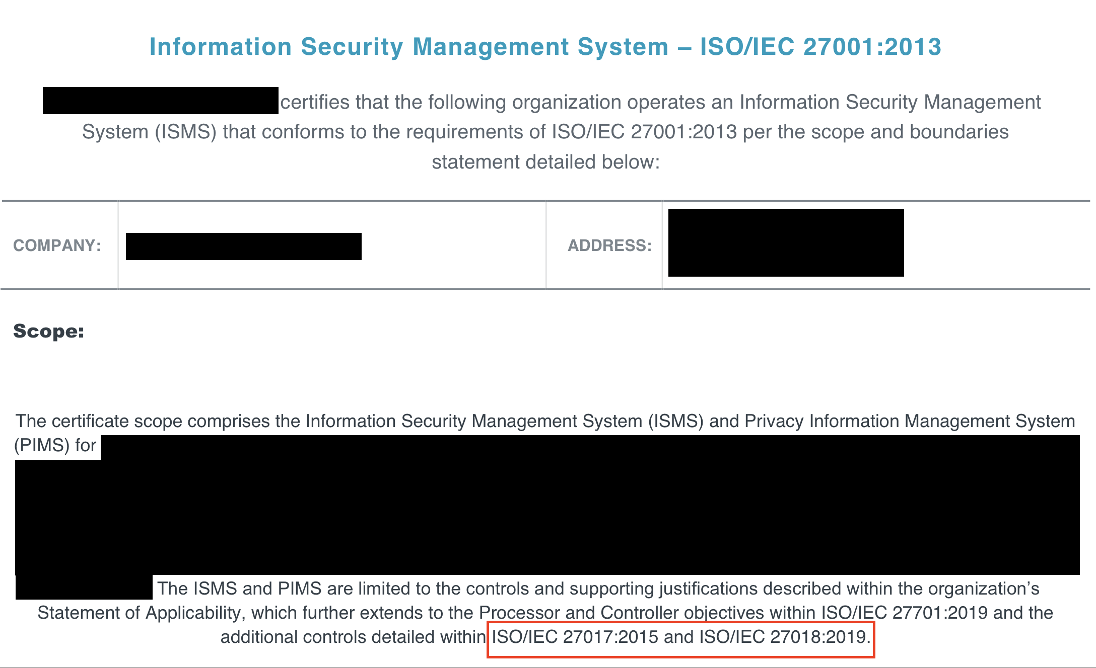
ISO 27701:2019 – EXAMPLE CERTIFICATE

Slide 31
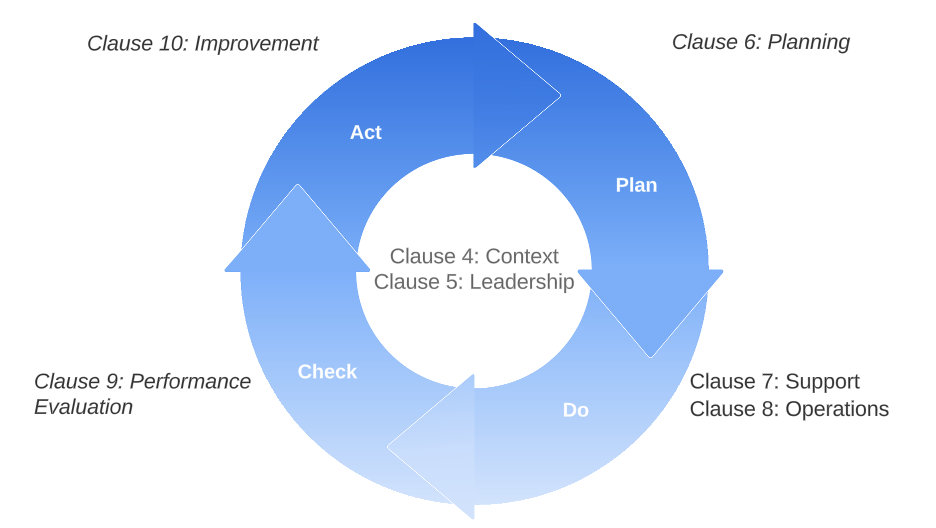
ISO 9001 – QMS
Notes:
https://advisera.com/iso-9001/

Slide 32
ISO 9001:2015 – FRAMEWORK OVERVIEW
Leading international standard focused on quality management
Not a compliance standard
7 quality management principles numbered through C.4 through C.10
Are the requirements mandatory?
  No, only relevant requirements are applicable, and the organisational policies form the reference for the audits
Mandatory Documents
Scope of the QMS (clause 4.3)
Quality policy (clause 5.2)
Quality objectives (clause 6.2)
Criteria for evaluation and selection of suppliers (clause 8.4.1)
Others listed on a subsequent slide
Notes:
Published by the International Organization for Standardization (ISO), in partnership with the International Electrotechnical Commission (IEC)

Slide 33
ISO FRAMEWORKS - IMPLEMENTATION PROCESS

Slide 34
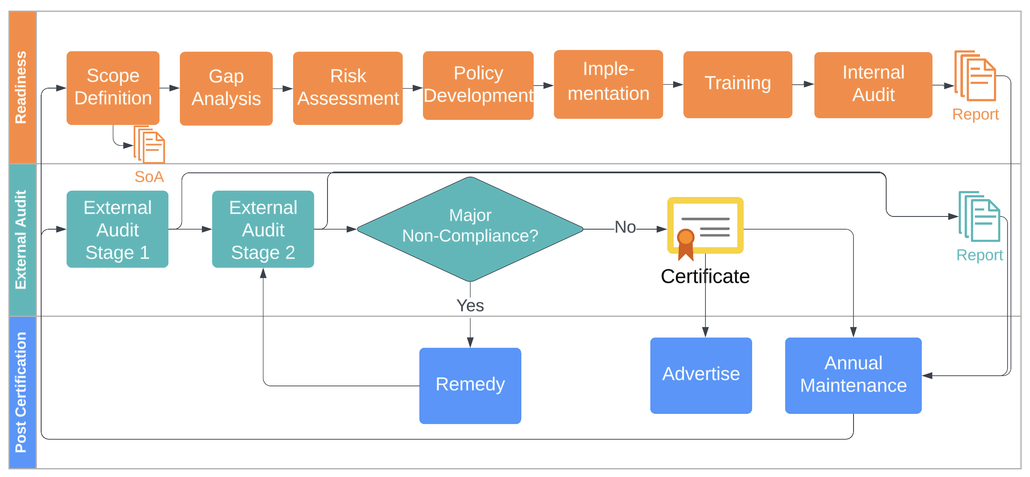
ISO PROGRAM OVERVIEW

Slide 35
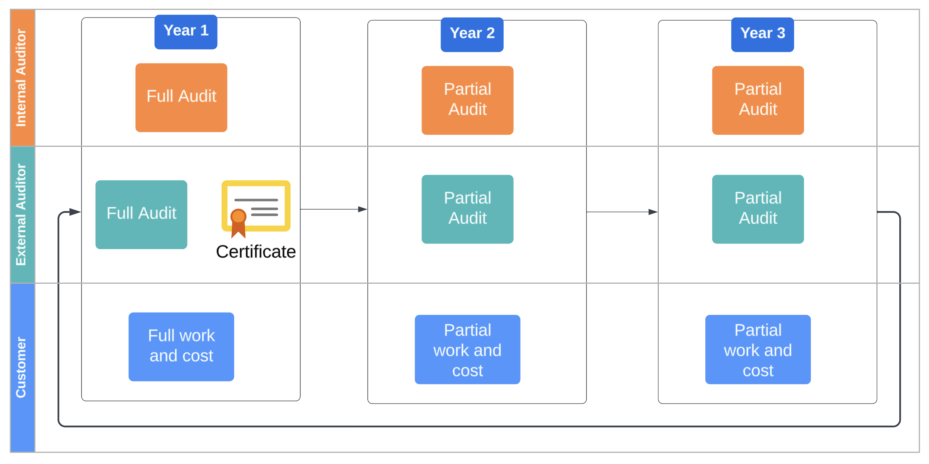
ISO MAINTENANCE
Notes:
The cert needs to be renewed every 3 years
Full certification audit is required every 3 years
Surveillance (partial) audits required every 2nd and 3rd year
Cost and effort reduce to almost 50% every 2nd and 3rd yeaR

Slide 36
SUPPORTING INFO

Slide 37
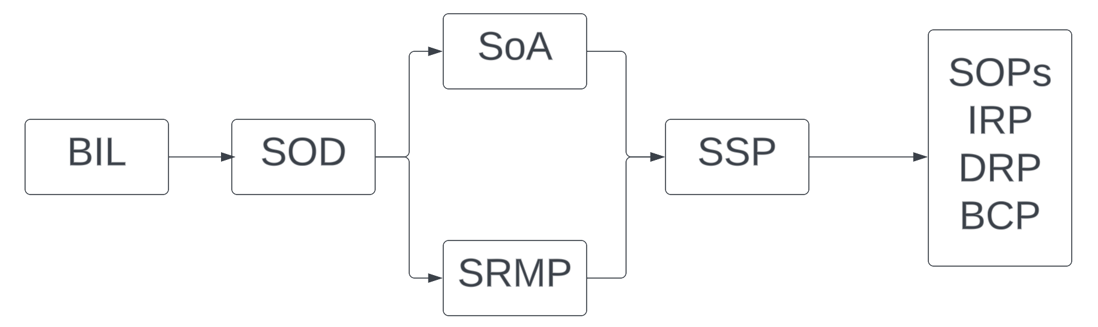
IRAP – IMPORTANT ARTEFACTS
Input:
BIL: Business Impact Level
SOD: System Overview Document
SoA: Statement of Applicability
SRMP: Security Risk Management Plan
SSP: System Security Plan
SOPs: Standard Operating Procedures
IRP: Incident Response Plan
DRP: Disaster Recovery Plan
BCP: Business Continuity Plan
PMP: Patch Management Plan
ELP: Event Logging Plan
KMP: Key Management Plan
Output:
IRAP Assessment Report
POAM: Plan Of Action and Milestones

Slide 38
ISO 27001 – IMPORTANT ARTEFACTS
Policies | Procedures and Other Documents
Information Security Policy ISMS Scope Definition Document ISMS Committee Charter ISMS Risk Management Framework Human Resource Security Policy Code of Conduct Asset Management Policy Access Control Policy Data Governance Framework Secure Software Development Policy Operations Security Policy Change Management Policy Vulnerability Management Policy Patch Management Policy Malware Protection Policy Configuration Management Policy Vendor Governance Policy Physical Security Policy AI Governance Policy | Statement of Applicability (SoA) ISMS Actions and Continuous Improvement Procedure Internal Audit Procedure Procedure for the Control of Documented Information Business Continuity Plan and Test Report Disaster Recovery Plan and Test Report Incident Response Plan and Test Report Information Security Communication Plan ISMS Relevant Laws, Regulations, and Contractual Obligations Risk Register Asset Register Vendor Register Intellectual Property Register ISMS Training ISMS Committee Meeting Pack Audit Reports

Slide 39
ISO 9001 – IMPORTANT ARTEFACTS
Mandatory Records | ISO 9001 Clause
Monitoring and measuring equipment calibration records | 7.1.5.1
Records of training, skills, experience and qualifications | 7.2
Product/service requirements review records | 8.2.3.2
Record about design and development outputs review | 8.3.2
Records about design and development inputs | 8.3.3
Records of design and development controls | 8.3.4
Records of design and development outputs | 8.3.5
Design and development changes records | 8.3.6
Characteristics of product to be produced and service to be provided | 8.5.1
Records about customer property | 8.5.3
Production/service provision change control records | 8.5.6
Record of conformity of product/service with acceptance criteria | 8.6
Record of nonconforming outputs | 8.7.2
Monitoring and measurement results | 9.1.1
Internal audit program | 9.2
Results of internal audits | 9.2
Results of the management review | 9.3
Results of corrective actions | 10.2
Recommended Documents | ISO 9001 Clause
Procedure for determining context of the organization and interested parties | 4.1 and 4.2
Procedure for addressing risks and opportunities | 6.1
Procedure for competence, training and awareness | 7.1.2, 7.2 and 7.3
Procedure for equipment maintenance and measuring equipment | 7.1.5
Procedure for document and record control | 7.5
Sales procedure | 8.2
Procedure for design and development | 8.3
Procedure for production and service provision | 8.5
Warehousing procedure | 8.5.4
Procedure for management of nonconformities and corrective actions | 8.7 and 10.2
Procedure for monitoring customer satisfaction | 9.1.2
Procedure for internal audit | 9.2
Procedure for management review | 9.3

Slide 40
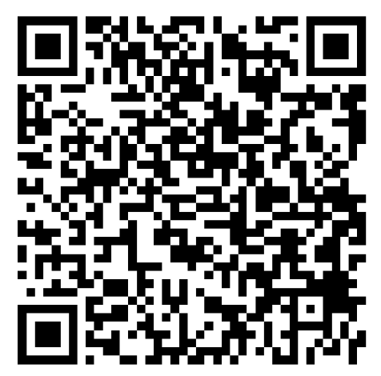
THANK YOU
Gaurav Vikash
gaurav@cybernion.com
0404 760 923

